Slide 1
Methods as Critical Junctures
Research Logics
For Interpretive Qualitative Inquiry
Annette Markham
Aarhus University
May 9, 2011

Slide 2
Annette’s Remix
The Saturated Self
Kenneth Gergen
Interpretive Sociology
Homo Narrans
Howard Becker, Norm Denzin
Ethnography
Distributed Identity
Erving Goffman
Symbolic Interactionism
Individualized Realities
Karl Weick
Organizational Studies
Fabrication as Ethical Practice
Michel Foucault

Slide 3
Early 1990s
“we have to decide fairly soon what it is we as humans ought to become, because we’re on the brink of having the power of creating any experience we desire” (Rheingold, 1991)
“ It will deeply change politics, culture, and the fabric of society—if not, indeed, the very metaphysics of human existence” (Wright, 1994)
“Virtuality through computer mediated communication announces the end of the body, the apocalypse of corporeal subjectivity” (Keeps, 1995)
Notes:
So let’s look at the cultural moment of early internet adoption. And the trends in social research, broadly speaking (and oversimplified for purposes of making an argument)
The early 1990s marked a period of intense attention on the technology, the nature of embodiment, the virtual. People are doing a lot of inventive analyses, using their own experience as guide. Focusing on the mechanics of hypertext, the shape of cyberspace.
We’re also in the time period when postmodern thinking hits the streets in more popular, user friendly form. Films like natural born killers and Natural Born killers, dismantled the barrier between audience and film, self and action of the film. Later, Run Lola Run does another twist on this.
In sociology, there’s an impulse to reconsider what counts as research, to embrace autoethnographic or decentered ways of knowing (following the path of Geertz, then Clifford and Marcus, then situated feminists like Sandra Harding and Donna Haraway). This is most extremely expressed by inteerpretive sociology in the U.S., where we see a lot of experimentation with methods of analysis and representation in different genres of writing.
Salient Characteristics of the 1990s
disembodiment
text as being
geographic displacement/dispersion
meant challenges for ethnographic research:
interviewing both online or offline?
authenticity? in the body or in the content of the text?
where is real experience? online or offline or a mix of both?
participation as active building of field boundaries
storing and managing huge amounts of field data
ethical practice of protecting privacy and getting informed consent
About virtual reality, Rheingold (1991) told readers “we have to decide fairly soon what it is we as humans ought to become, because we’re on the brink of having the power of creating any experience we desire” (p. 386, emphasis in original). Wright (1994) told us simply that it would “deeply change politics, culture, and the fabric of society—if not, indeed, the very metaphysics of human existence” (p. 101). Barlow offered a vision of Cyberspace as the Wild West, a final frontier to be claimed: “Cyberspace . . . Is presently inhabited almost exclusively by mountain men, desperadoes and vigilantes, kind of a rough bunch. . . . And as long as that’s the case, it’s gonna be the Law of the Wild in there”(cited in Woolley, 1993, pp. 122-123). Keep (1995) suggested that virtuality through computer mediated communication “announces the end of the body, the apocalypse of corporeal subjectivity” (p. 4).

Slide 4
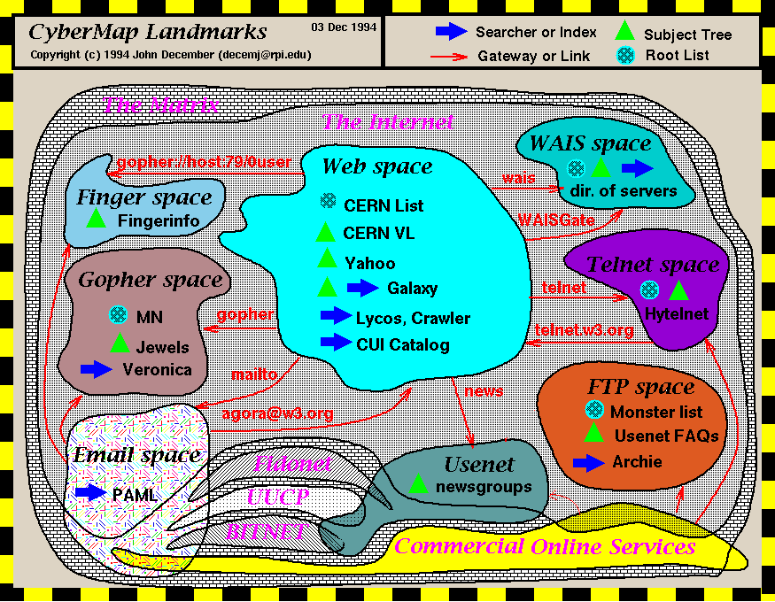

Slide 5
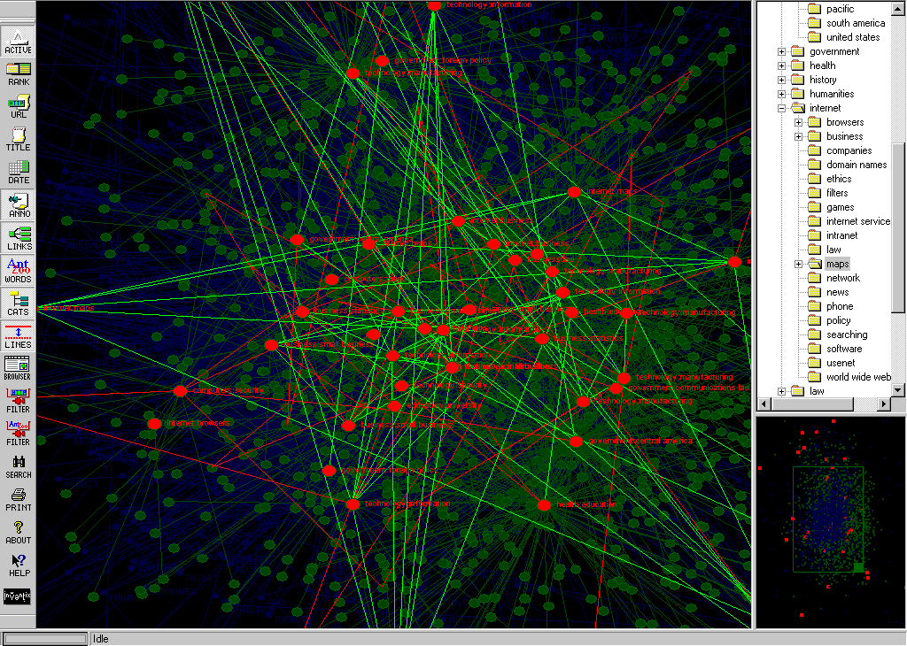

Slide 6
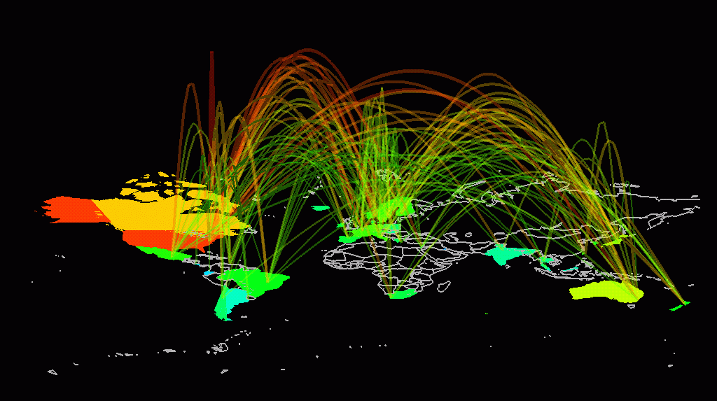

Slide 7
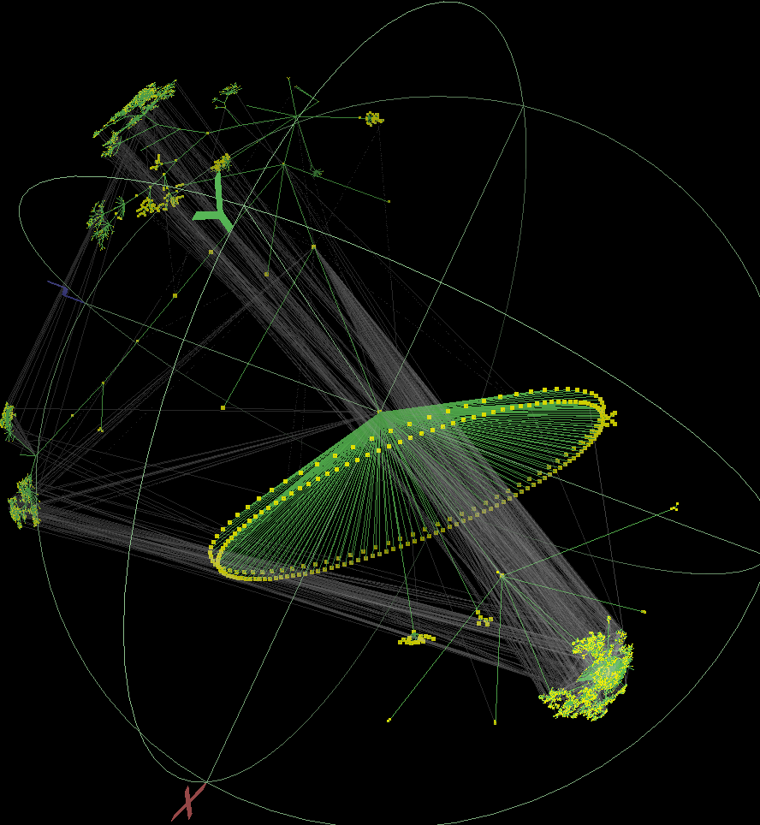

Slide 8
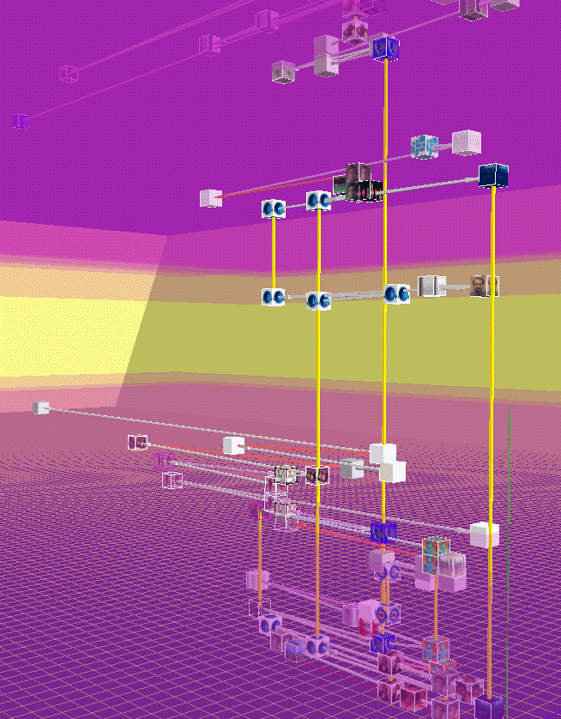

Slide 9
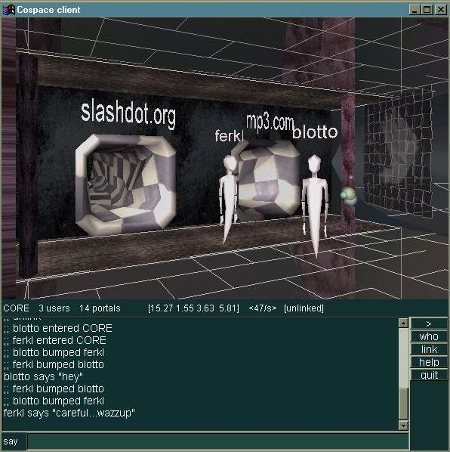
Notes:
Early fascination with networks of information flow grew more and more geographic and dimensioned.

Slide 10
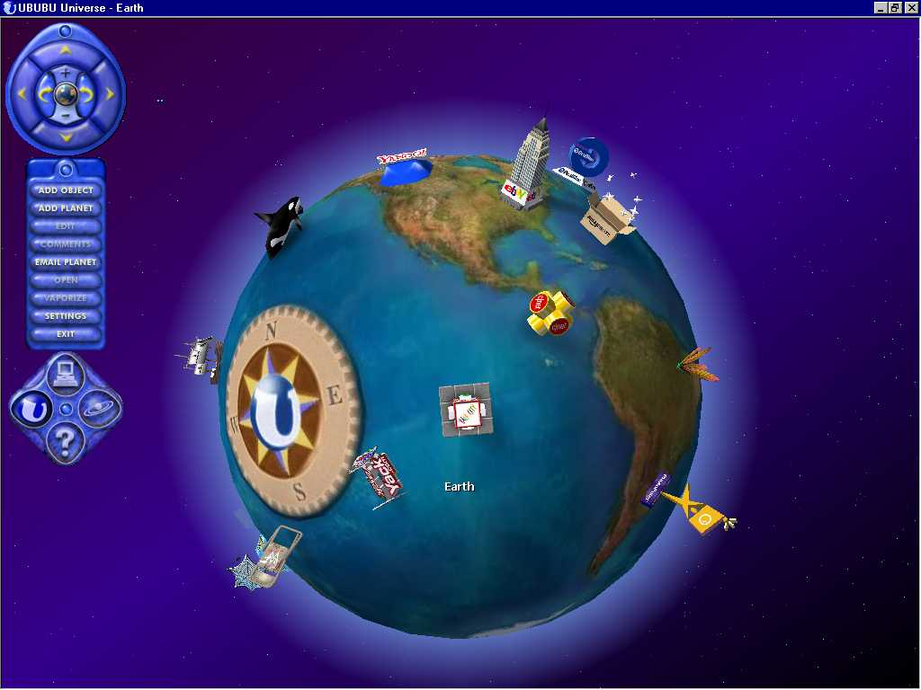
Notes:
Early fascination with networks of information flow grew more and more geographic and dimensioned.

Slide 11
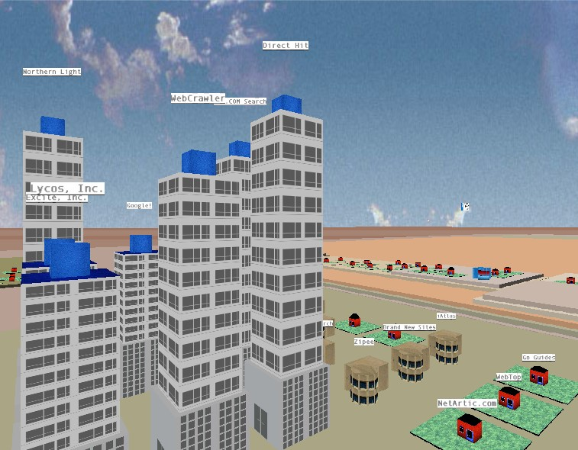

Slide 12
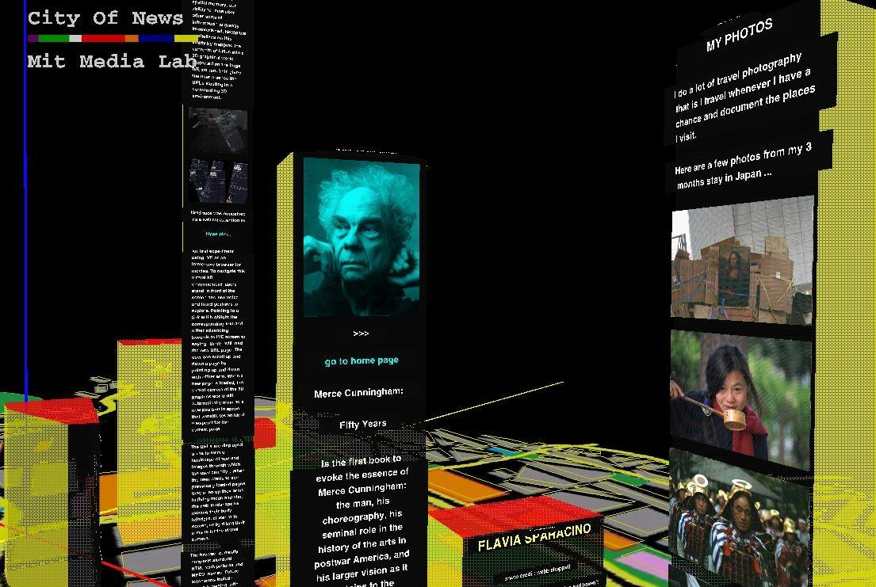

Slide 13
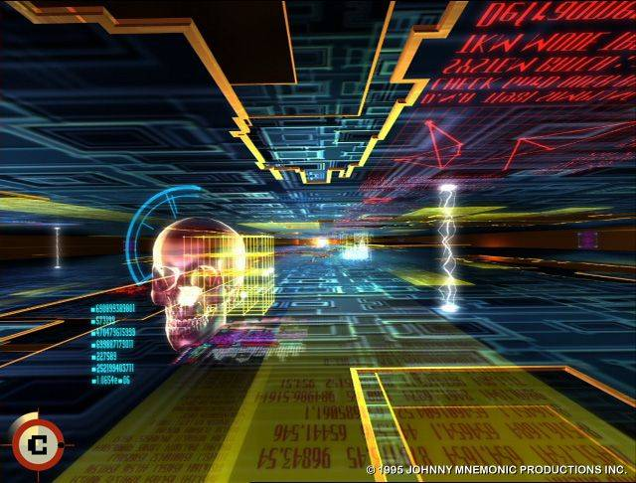
Notes:
The creation of the platforms happened in parallel with films of the decade that envisioned a merging of human and machine, the creation of unique lifeworlds for our avatar selves.

Slide 14
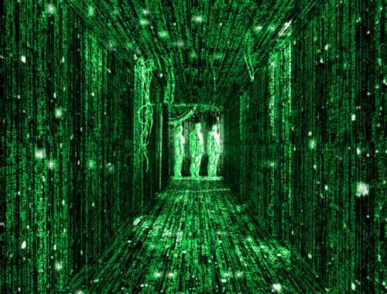

Slide 15
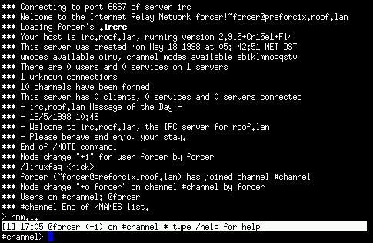
Notes:
Yet in all of it, this was our method of communicating in cyberspace. No wonder there was a focus on the body when the body was so glaringly absent yet viscerally present.

Slide 16
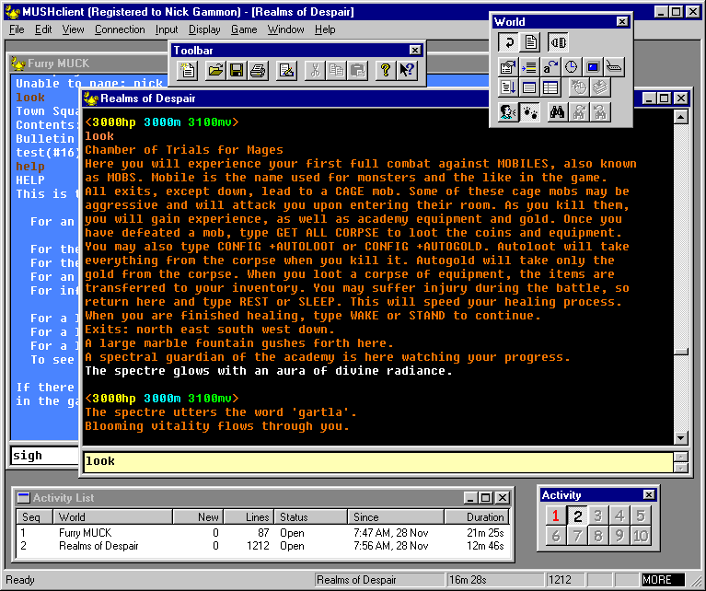

Slide 17
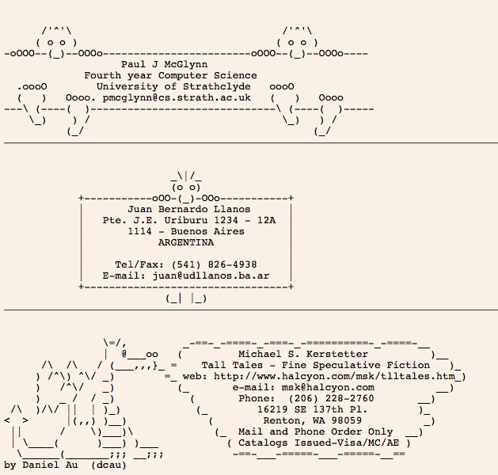

Slide 18
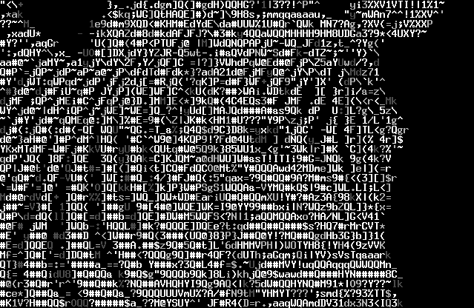

Slide 19
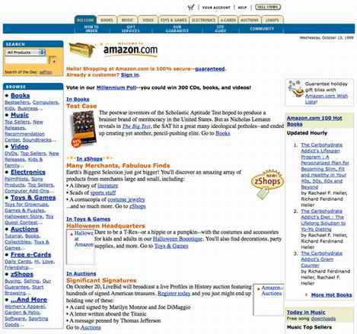
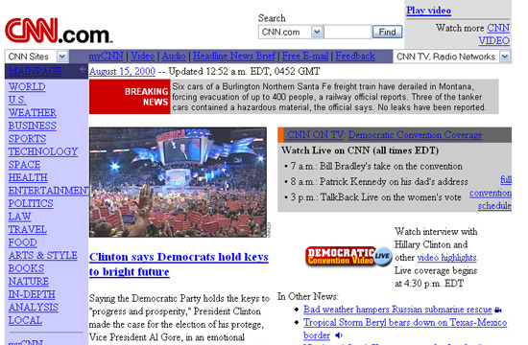
Notes:
Then, in the mid 1990s, the focus of research turned to the WWW as a visually dominated space for commerce and personal production of personal pages.

Slide 20
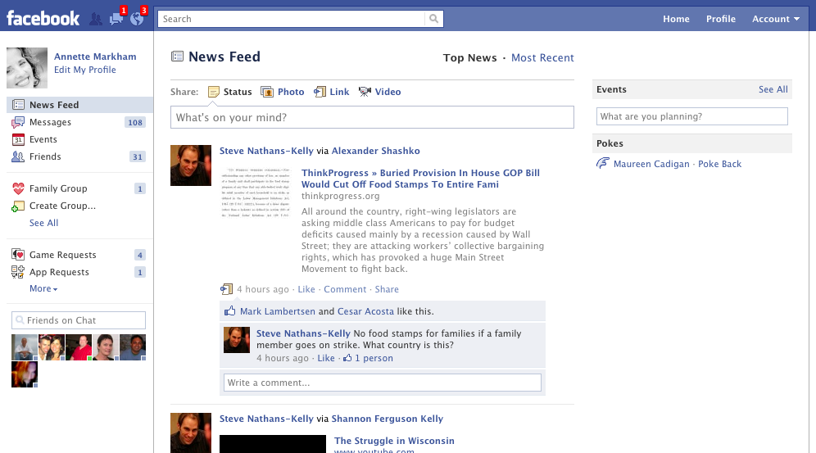
Notes:
Concurrently, we see a rise in studying networks, or larger pictures of society, based on the more robust web and the growing social use of the web as a networking tool.
Now, our parameters for what is appropriate for an interface have changed somewhat. If we’re not in a gaming environment or ‘alternative’ space, this is the classic look of the stage upon which we now play.

Slide 21
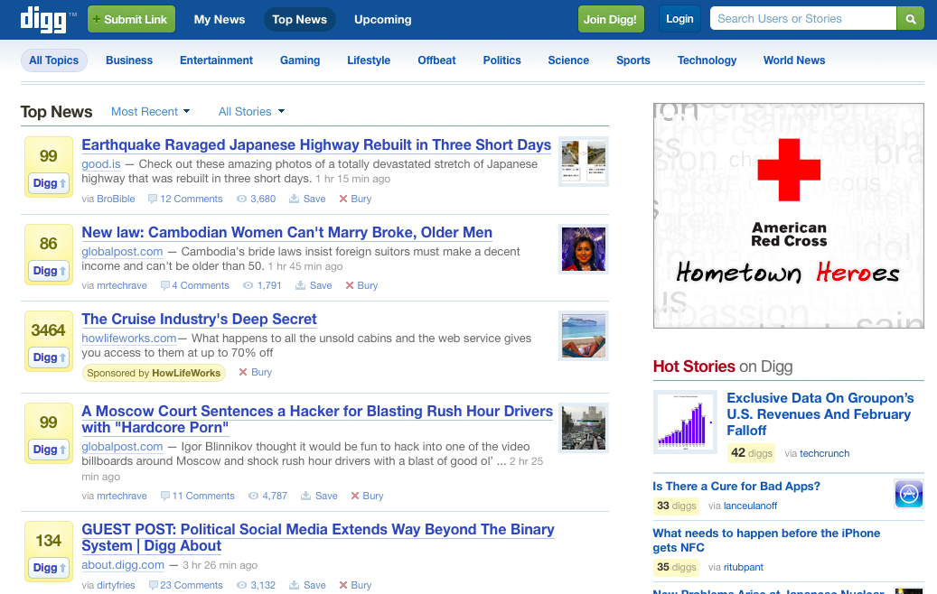

Slide 22
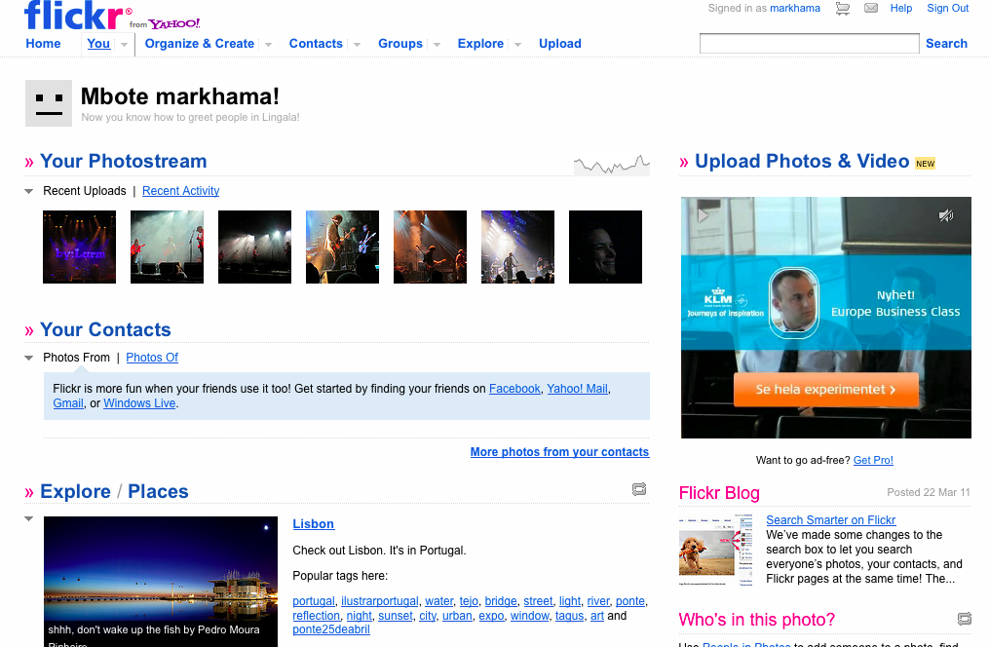

Slide 23
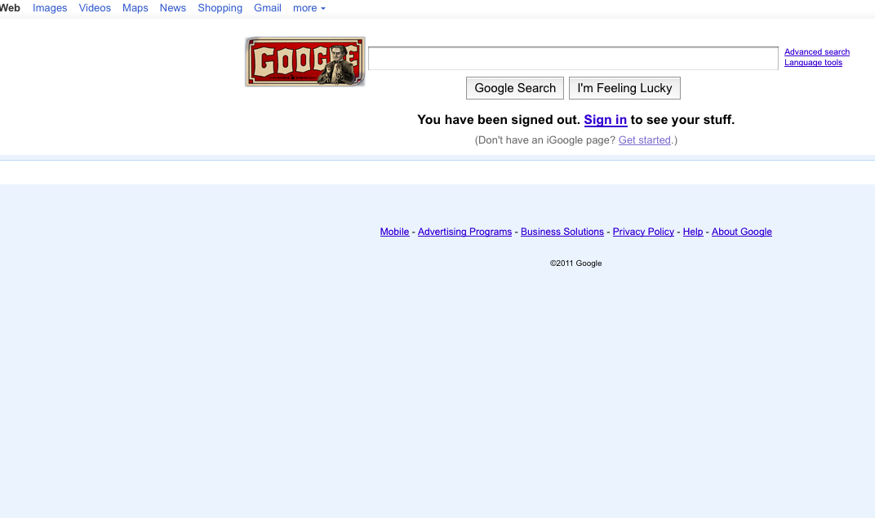
Notes:
And the ever present google, which is revered for its minimalism.

Slide 24
2011
“Who should I accept as a friend? Everyone I know or just people I like?” (U.S. teen talking about Facebook)
“What role does social media play in protest movements, like Egypt or Wisconsin?” (everyone)
Should I be angry or try to sue people for spreading my photography all over the internet or just be glad I was noticed? (Noam Galai)
“How can musicians engage their fans through social media?” (Nancy Baym)
Notes:
It’s no wonder the questions have shifted. Instead of radicalizing the cultural parameters, we’ve (or they’ve) erased the obviousness, created interfaces that are transparent.
So whereas we used to see the frames out there in front of us, we now have stepped into the frames.
IMPORTANT: I don’t mean to imply these plain interfaces are the only way we experience media and internet. There’s a huge range of experience possible in vivid color and movement and detail. But this is our ‘everyday’ space. The visionary platforms became quite vanilla.
Methodologically, I have to ask NOT ONLY what have we gained, but what has been lost? I’ll be frank in my admission that this is my own personal observation, having been in this discipline since 1994.
Variation and experimentation, Invention and creativity: these may be tolerated, but they are still not explored as premises for sound or rigorous scholarship.

Slide 25
Culture
21.^{c}
Multiple interfaces for experiencing information
Increased convergence
Ubiquitous Internet
Extensive networks of personal connection
Always On, Always Connected
Notes:
Arguably, the world keeps getting more complex, in terms of our understanding of what is the self, what is culture, and what is real.
In countries with high internet, computer, and smart phone penetration, life in the 21st Century is marked by
Converging media forms to provide ubiquitous connectivity to networks of information.
More extensive networks of personal connection (facebook, e.g.)
More devices for ‘always on’ (e.g., smart phones and tablet devices such as ipad)
More interfaces for experiencing information (youtube, twitter, facebook) (hulu, netflix, spotify) (storify, vimeo)
So what do we get through this always on, global, multiphrenic state?
Let me show some snapshots of what this looks like to me, in my recent experience. As I mentioned earlier, I get my reality from my friend network on FB and twitter. Each of us would show a different remix of this:

Slide 26
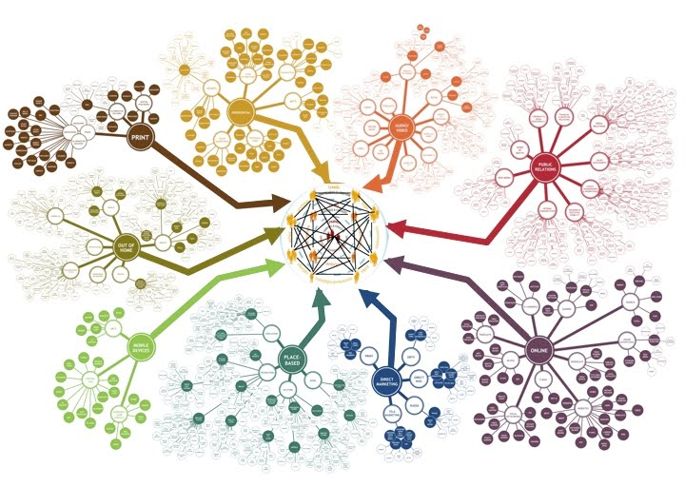

Slide 27
Questions I’ve been asking
Are methods of sensemaking adequate?
Are our methods still protecting participants?
Why is there (still) a persistent cry for accuracy and truth?
Are we afraid to take risks in methods?
Notes:
Do our models for ethnography work when the field is constructed much more by interaction than geographically bound spaces and when participant definitions of ‘culture’ seem frenetically and insistently more global than local?
Do our methods for looking at interaction adequately reflect the modes of interaction possible?
Can our thought processes as researchers fit into traditional or even contemporary social science norms for data collection, analysis, and reporting when our own experiences of the research are situated in our own multiphrenic experience of the world?
These questions have haunted me for almost 20 years now. They seemed obvious questions in the early 1990s

Slide 28
Remix or Bricolage
Interrogate
Play
Borrow
Move
Generate
Notes:
But seriously, what does it involve?
Borrow from anything. Any way of knowing. Any epistemological framework. Any philosophy. Any art
Generate lots of data
Play with multiple methods, testing and practicing
Move. As in shift your perspective, change the questions, follow the data, move in and out of the flow of information
Interrogate the self, the project, the purpose. All the time. That’s where ethics comes from.

Slide 29
My Method Mantra
Method is never monolithic. Or static.
Methods are ethical and political choices.
…With consequence.
Quality is about reflexivity, not universality.
Notes:
Second, there’s never only one method. We might have a particular starting point or question or epistemology, but this swiftly morphs into multiple methods of collecting, sorting, analyzing, and writing.
All the writers you’ve read for today emphasize that it’s critical to understand where qualitative inquiry is situated; as a situated, inductive, non-generalizing practice.

Slide 30
Phenomenon
questions
actions
exploration
collecting
managing
categorizing
interpreting
writing
The Answer
TEXTS
…or objects that
function as texts, in
that they can be “read.”
Notes:
A phenomenon prompts you to ask questions.
These questions lead you to some action. …
Whereby you explore, by virtue of gathering information, filtering and making sense of it in some way, and presenting your ideas to others, usually through writing.
And generally, the researcher looks at TEXTS.

Slide 31
Phenomenon
questions
actions
exploration
collecting
managing
categorizing
interpreting
writing
The Answer
Phenomenon
Filtered
Through one’s
Situated worldview
whereby meaning is
Framed
Edited, Refined
and
(re) presented
An Impression
Notes:
Focusing on the potential consequences of our actions, we can see that

Slide 32
Methods = Choices
Hopefully, more like decisions than habits.
Notes:
When we think about ethics, we think about moral choices. This is exactly what occurs in the process of doing research.
My goal in the next few minutes is to talk about some of the ways methodology training has failed by not recognizing this or by not making it more obvious, so novice scholars could understand their methodological procedures as ethical decisions.
(parenthetically, I hope you discern an underlying criticism of blitheness, demonstrated egregiously by the social sciences hiding behind their strict adherence to traditional procedures, but even more annoying in qualitative researchers because they should know better and they have more license to be conscious)
So: Methods are nothing more or less than a series of ethically laden choices at critical junctures throughout a project. (Hopefully, more like decisions, rather than habit.)
Most training is either FOREST AND / OR TREES. Not much in between. Even when spelled out more specifically, still focuses on either the big picture level or minute detail level.
While these are all very useful frameworks for our action, it’s very improbable that an actual study would use only one approach, or that one approach would adequately describe what we actually do when we are working on a project.
Least guidance for the BETWEEN
We have the least guidance (methodologically speaking) on the part that is the most challenging; the stuff between “going into the context” and “writeup”.
If we think about what we’re actually doing in the project, method becomes a much more interesting and flexible thing: I want to talk about this.

Slide 33
method
decision
action
method
decision
action
method
decision
action
method
decision
action
method
decision
action
method
decision
action
method
decision
action
method
decision
action
method
decision
action
method
decision
action
Notes:
RETHINKING METHOD AS MULTIPLE CHOICES (NOT HABIT) = ONE WAY TO GET FURTHER.
This is good, but I find it much more useful, practical, and ethical to conceptualize a study in moments, critical junctures where we make decisions about how to proceed.

Slide 34
Critical Junctures / Decision Points
?
?
?
Notes:
What path should we take now? Paths taken, paths not taken
Each ‘time you make a choice, you delimit the parameters of the study. Each decision whether it’s dismissed as just a practical decision or a deliberate methodological decision, eliminates multiple alternate options. For me, these decision points are critical junctures, with moral consequences for the participants, the culture, and knowledge production.

Slide 35
Framing Knowledge for the audience
Generating Questions
Representing self and other in report
Determining field boundaries
Decision Points
Critical Junctures
Identifying objects of analysis
Interpreting findings
.
Analyzing ‘texts’
Accessing Participants
Discarding information
Collecting Information
Sorting into general themes
Sorting and filtering ‘data’
Notes:
When you think about all the practical as well as methodological choices you make, it gets a bit dizzying. CLICK
Each of these junctures involves active behaviors on the part of the researcher.
Each of these utilizes a unique method or tool, whether or not this methodology is articulated or deliberate.
Example:
Where to cut off participant list
Which search engines to sample
Which language to speak
Whether to restrict interaction to online or take offline to f2f
What time of day to seek interviews
What time zone to use
Some = questions of logistics, some decisions made by convenience. All of these with ethical implications.
ALL OF THESE DECISIONS ARE ETHICS DECISIONS. WITH CONSEQUENCES:
Consequences for the human subject, sure. That’s what we are taught to focus on because of the daunting presence of the IRB committees. But there are so many more consequences when we look more deeply at our methods as choices.

Slide 36
Where
What
Object of inquiry
Object of Inquiry
When
Why
Who
How
Notes:
So for me, these are much more important questions than whether or not I’m doing a multi-sited, net tech remix ethnography: How am I cutting into the phenomenon to identify an object of analysis? PAUSE TO ALLOW SILENT READING
I’m going to show you five more slides that get deeper and deeper into the multi-layered process of doing ethnography, or using ethnography as an epistemological lens for conducting qualitative social inquiry. I want to spend time talking about Go Ugly Early as a project, so I’m not going to talk about these five slides; just show them. You don’t have to take notes; I can give you mine.
So in addition to asking these questions at a general conceptual level I also ask: CHANGE SLIDE

Slide 37
Where are we located and why does that matter? Where is the study situated?
What is the phenomenon? What are we choosing as the point of analysis?
Object of inquiry
Object of Inquiry
When are we doing research?
Why do it? Whose interests does this study serve? What is our goal?
Who are the agents/actants, beyond the obvious? Who are we?
How are we conceptualizing? How are we approaching?
Notes:
So for me, these are much more important questions than whether or not I’m doing a multi-sited, net tech remix ethnography: How am I cutting into the phenomenon to identify an object of analysis? PAUSE TO ALLOW SILENT READING
I’m going to show you five more slides that get deeper and deeper into the multi-layered process of doing ethnography, or using ethnography as an epistemological lens for conducting qualitative social inquiry. I want to spend time talking about Go Ugly Early as a project, so I’m not going to talk about these five slides; just show them. You don’t have to take notes; I can give you mine.
So in addition to asking these questions at a general conceptual level I also ask: CHANGE SLIDE

Slide 38
Performance Theory
Semiotics
Organizational sensemaking
Object of inquiry
Object of Analysis?
Where are we coming from?
Structuration
Symbolic interactionism
Communication as Ritual
Social Constructionism
Rhetorical Theory
Actor Network
Etc., etc.
Grounded Theory
Notes:
What theoretical premises am I using to make sense of what I’m studying? Another way to ask this question of “how are we cutting into this problem?” is to ask: Where are we coming from?
Undoubtedly, when we conduct interpretive research, we use whatever tools we have available. It’s important to identify some of our influences, so we can understand the strength of what these perspectives bring us, rather than thinking of one method as monolothic

Slide 39
Ontology of Relationships and Connections
Processes in which entities are situated
Intersecting Contexts
Object of inquiry
Object of Analysis?
Complexity of the process of Interpretation
Polysemy
Multiple Epistemologies
Myth of Universalism
Intertextuality
Fictive dimension of research findings
Discursive Construction
Power/Knowledge
Interpretive aspect of all knowledge
Notes:
What theoretical premises am I using to make sense of what I’m studying? Where are we coming from?

Slide 40
Follow the Thing
Follow the People
Follow the Conflict
Object of inquiry
Follow the opposites
Object of Analysis?
Follow the Plot, Story, or Allegory
Where are we going?
Follow the movement
Follow the metaphor
Follow the intersections
Follow the Life or Biography
Follow the …etc., etc.
Follow the between
Notes:
Where are we going? How do we proceed to make sense of the phenomenon?

Slide 41
MICRO
Contrived Discourse
(interviews, focus groups)
Absence. Silence. Deletions.
Naturally occurring discourse
Object of inquiry
Object of Analysis?
Traces of self
What are we analyzing?
Actions or evidence of actions. Performances.
Objects, Technologies
Cultural/Social Outcomes
Structures, Meaning, Norms, Institutions
MACRO
Notes:
What exactly are we focusing on as ‘data’ which will be used to measure, assess, describe, contain, and further delimit the object of analysis?

Slide 42
Conversation
Analysis
Discourse analysis
Object of inquiry
Metaphor Analysis
Object of Analysis?
What analytical tools?
Linguistic Analysis
Narrative Analysis
Visual Analysis
Etc., etc.
Notes:
How are we attending to and making sense of the stuff we collect from fieldwork, interviews, observations, and so forth?

Slide 43
To provide therapy for cultural members
Social Justice
To create sustainable futures
To Describe
To Understand
To Explain
To Predict
To Control
To Critique
Object of inquiry
Object of Analysis?
Why?
To Publish
To Prove Yourself
To get Funding
To get Tenure or Promotion
To fix a problem
Notes:
And finally, why are we doing research in general?

