Slide 1
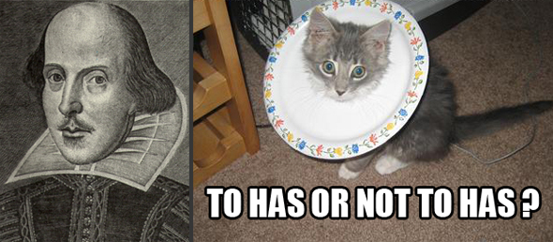
(Re)Mixing it up:
Creative reframing,
Qualitative methods, &
Socially responsible research
Annette N. Markham, PhD
University of Sheffield
June 6, 2012
Notes:
A couple of years ago, two events sparked my interest in the idea of remix as a metaphor to think differently about how we do research
I caused a small firestorm at an ethics workshop I was leading when I mentioned mentioned that I invented a dialogue in a study
My two swedish colleagues got a paper rejected because they invented blog was considered ‘fabrication of data’
Responses were polarized: How can I ever trust anything you say again? The text is sacrosanct! Others said “thank you”
I was surprised at the immediate, visceral negative response.

Slide 2
Post-Presentation Note:
This is not really a print-friendly document. The presentation is best viewed as a slideshow, since a few slides have animated effects. Informal speaker notes are located in the notes section, so if you have a ‘presenter view’ option, this is really the best format for viewing.
Some slides were hidden because I wasn’t sure of the time limit for the presentation. These won’t be seen in slide show mode, but could be viewed in normal view.
IThe use of potentially copyrighted materials is for this presentation only. Use is deemed to be within US doctrine of Fair Use, as they intend to be a temporary illustration in an educational presentation. Detailed references can be supplied on request. Sources for images can be supplied on request.
Please contact meif you want to use part or all of this presentation.
Thank you,
Annette Markham
Email: amarkham@gmail.com
Twitter: @annettemarkham
Bio/Web/Blog: http://markham.internetinquiry.org/
Please cite:
Markham, A. (June 2012). (Re)Mixing it up: Creative reframing, Qualitative methods, &Socially responsible research [Power Point Slides]. Creative Methods in Social Science Workshop. ICOSS. Sheffield, UK. Available from: http://markham.internetinquiry.org/writing/sheffield2012.pptx

Slide 3

Frames
Notes:
It got me thinking a lot about frames. How could this seemingly homogeneous group ‘frame’ social science so differently?
NEW POINT: The interesting thing about frames, as social psychologist Erving Goffman noted, is that they draw our attention to certain things and obscure other things (In this traditional type of frame, for example, it’s what’s inside and outside the frame)

Slide 4

Notes:
So if I tell you this is a frame, it will also highlight and hide certain aspects, but in a different way. You might see dimension, an inside, an outside, and perhaps movement

Slide 5
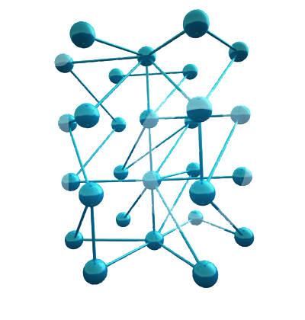
Notes:
Or if this is a frame, we might focus on the fact that everything (almost) is interconnected

Slide 6

Notes:
This one? I don’t know what It means. There’s probably information in the frame itself that might give a clue as to it’s meaning,
but in general, frames are difficult to identify
because most of the time,
We don’t notice them; they function invisibly to shape our behavior

Slide 7
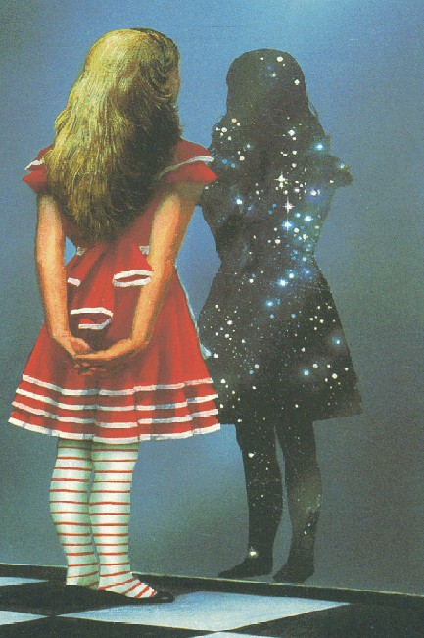
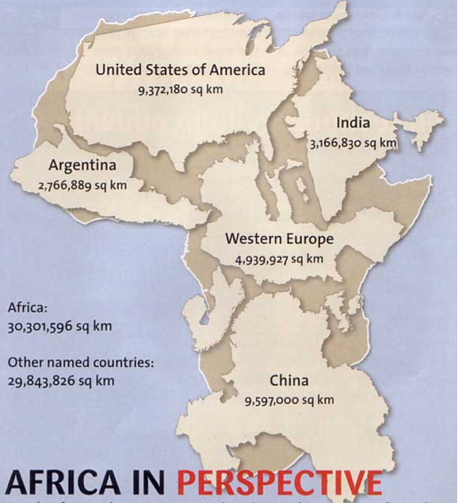
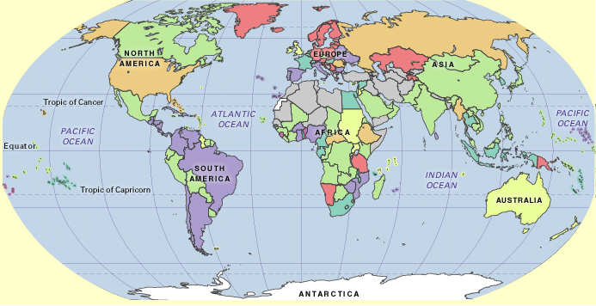
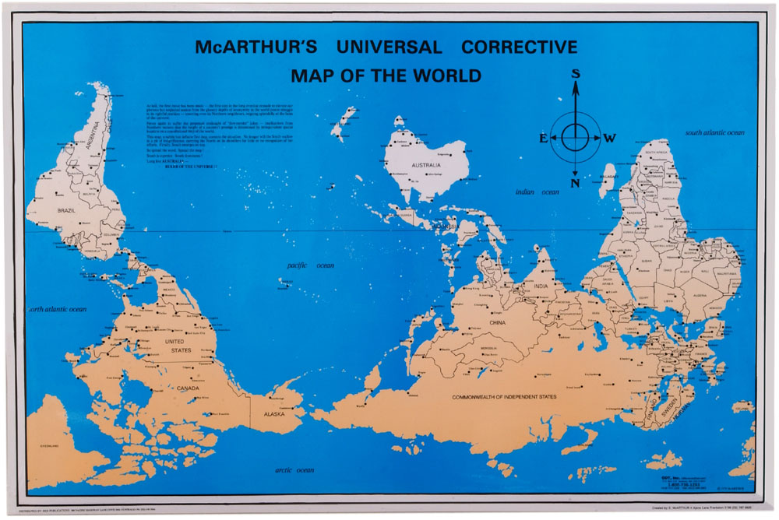
Notes:
…Like maps, if you will.
They provide a way of seeing that functions pretty seamlessly until something happens to cause to cause us to see the frame. Goffman called it a frame break. Garfinkel used to send his students out to deliberately break frames for everyday behavior so as to reveal these invisible structures. Classic eg – elevator.
My statement- frame break. All of a sudden, I’d offered a different frame. I couldn’t be dismissed as someone who doesn’t think about ethics or methods (and therefore doesn’t know what the frame should be). So it couldn’t be put off as an anomaly.
Since then, I’ve been asking more seriously some questions that used to just simmer in the back of my mind.
About some of the cultural and political conditions within which we find ourselves doing qualitative research,
which tells us something about why “inventing a dialogue” or “fabricating a blog” might be such a contested practice.
We live in a remix culture, people are doing creative remix all around us, and we researchers seem to be stuck with some degree of methodological hypochondria, where we are afraid of taking too many risks. It seems not just odd but unwise that we would remain restricted in the ways we contribute to this knowledge economy, when everyone outside the walls of the Academy has none of these restrictions.

Slide 8
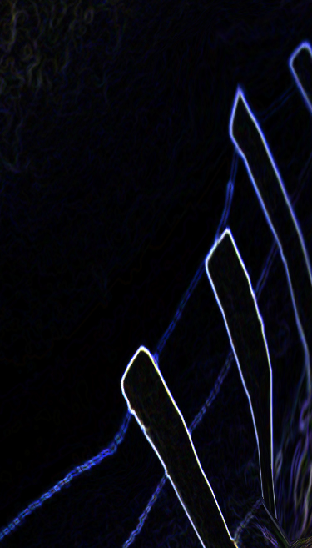
Questions
Are our methods of sensemaking adequate?
Why do positivist criteria for quality persist?
How can we translate traditional methods into frameworks that better fit into remix social media cultural contexts?
What might ethical and rigorous remix look like?
Notes:
1) Are our methods of sensemaking and representation adequate? And by this I mean more specifically:
Do our models for ethnography work when the field is constructed much more by interaction than geography?
Do our methods for looking at interaction adequately reflect the MODES of interaction possible?
Do our thought processes as researchers fit well with norms for data collection, analysis, and reporting when our experiences of research are situated in our own mediatized, networked, and digitally saturated multiphrenic experiences of the world?
2) Why does it feel like academia is battening down the hatches, in the midst of a cultural explosion of collaborative, open source, reputation knowledge production? Why do we see a strong persistence of traditional procedures and norms for ‘what counts’ as appropriate for qualitative research? Why are we afraid to take risks? Here I didn’t know whether to invoke the phrase “methodological hypochondria” or “empirical imperialism.” they both apply as reasons we don’t feel comfortable working outside the already-established parameters for qualitative research.
3) If we wanted to be more creative, inventive, and go ‘off template, what would that look like?
4) What creates rigor and credibility?
SO: MY MAIN TAKEAWAY POINT FOR TODAY IS THIS: To truly create in the social sciences, with such strict parameters for almost every move one might make, three stages are required (at least for me):
Recognize and jar loose of restrictions (traditions)
Reconfigure practice in new ways (not reinvent)
Figure out what makes something rigorous and credible and build this into the plan
In the next few minutes I want to walk you through some thoughts
What remix means to me
some of the cultural and political conditions within which we find ourselves doing qualitative research
What a remix method might look in practice (using the example of social media and the Japan earthquake last year)
What’s necessary to make it credible and rigorous.

Slide 9
Remix
is…
Creative Re-ensemble of units of cultural information
Temporary product that changes as others participate
Art
Comedy
Parody
Criticism
Like Bricolage, but also like a Terministic Screen.
“Not something we do in addition to real life, it’s what we do to make sense of what’s going on around us, to create sensibility out of the chaos of stimuli around us.”
Notes:
Remix, as an practice mostly connected with music, is the activity of taking samples from pre-existing materials to combine them into new forms according to personal taste.” (Eduardo Navas)
Through sampling and mixingongoing process of creative re-ensemble of units of cultural information,
Process of remix yields partial products that grow in quality and cohesion over time through feedback loops and further remix.
Relies on participation of others. It’s Networked knowledge, truly networked.
CLICK
It can be for comedy (like Dramatic Chipmunk or the Hitler meme)
Can be more complex constructions for parody (ten commandments)
Or can be used for critical commentary (hard working george)
But taken more broadly, remix is a way of knowing.
Remix is a bit like bricolage, but different.
It’s not something we do in addition to real life, it’s what we do to make sense of what’s going on around us, to create a sensible something out of the chaos of stimuli around us.
It’s also a bit like the notion of Terministic screens (Burke), or Framaing (Goffman)
Remix as a set of Tools of collecting and analyzing cultural information
And it as a range of means for producing and representing intellectual knowledge

Slide 10
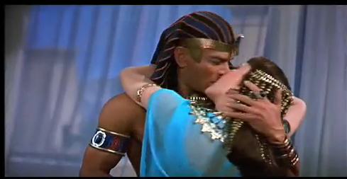
Remix
Is…
Ten Commandments Remix
http://www.youtube.com/watch?v=rfh4Mhp-a6U
Notes:
Let me show you two examples of typical remix, although you may already be very familiar with this type of thing

Slide 11
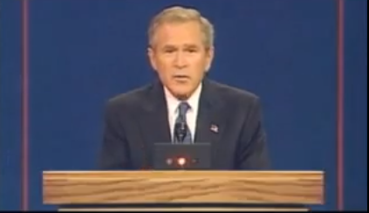
Hard Working George
http://www.youtube.com/watch?v=bi8zyp1je9Y

Slide 12
21st Century
Culture
Multiple interfaces
Increased convergence
Ubiquitous Internet
Extensive personal Networks
Always on, always connected
Decentralized creation and distribution of culture
Collapse between producer & consumer
Transmedia experience
Polarized, individualized versions of reality
Notes:
I’d love to show you about 20 slides to help you visualize how culture has shifted in the digital or internet age, but time doesn’t permit. Most of you are already too familiar with the ways we have become intertwined with media, the way social media have created extensive personal networks, and so forth. I am not going to go through these in detail, but I’m happy to talk about them later.

Slide 13
Early 1990s: “Cyberspace”
“we have to decide fairly soon what it is we as humans ought to become, because we’re on the brink of having the power of creating any experience we desire” (Rheingold, 1991)
“ It will deeply change politics, culture, and the fabric of society—if not, indeed, the very metaphysics of human existence” (Wright, 1994)
“Virtuality through computer mediated communication announces the end of the body, the apocalypse of corporeal subjectivity” (Keeps, 1995)
Notes:
THINK ABOUT CUTTING THIS SECTION. IT MAKES THE POINT ONLY TANGENTIALLY. REALLY, THE POINT I WANT TO MAKE IS THAT REMIX CULTURE MAKES OUR RESEARCH CONTEXTS MORE COMPLICATED. MAYBE REPLACE WITH JAPAN, SINCE THAT’S THE END EXAMPLE.
Prior to the commercialization of the internet. These were some prominent types of questions in social research, broadly speaking (and oversimplified for purposes of making an argument)
The early 1990s marked a period of intense attention on the technology, the nature of embodiment, the virtual. People are doing a lot of inventive analyses, using their own experience as guide.
Focusing on the mechanics of hypertext, the shape of cyberspace. (flip through following 7 slides to see some early visualizations of this, taken from the Cyberspace Atlas.
----- Meeting Notes (11/25/11 11:26) -----
The early 1990s marked a crucial moment in studies of digital culture because the internet was a place for virtual experience.

Slide 14
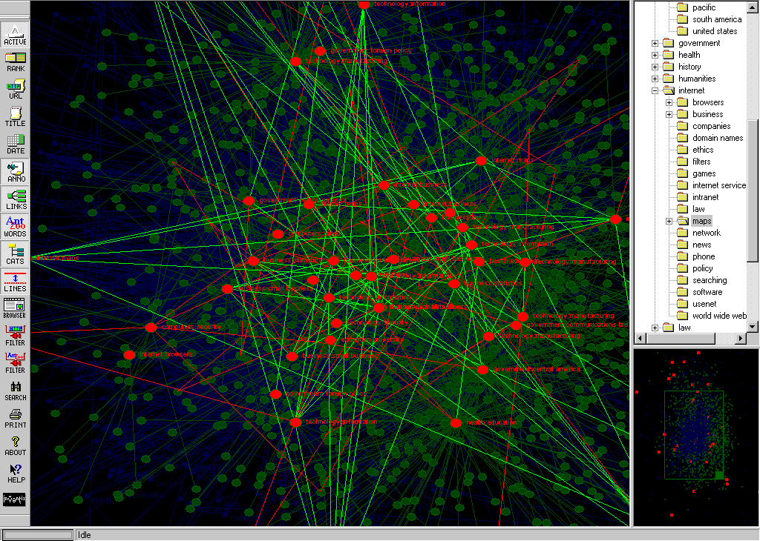
The Atlas of Cyberspace: http://personalpages.manchester.ac.uk/staff/m.dodge/cybergeography/atlas/atlas.html

Slide 15
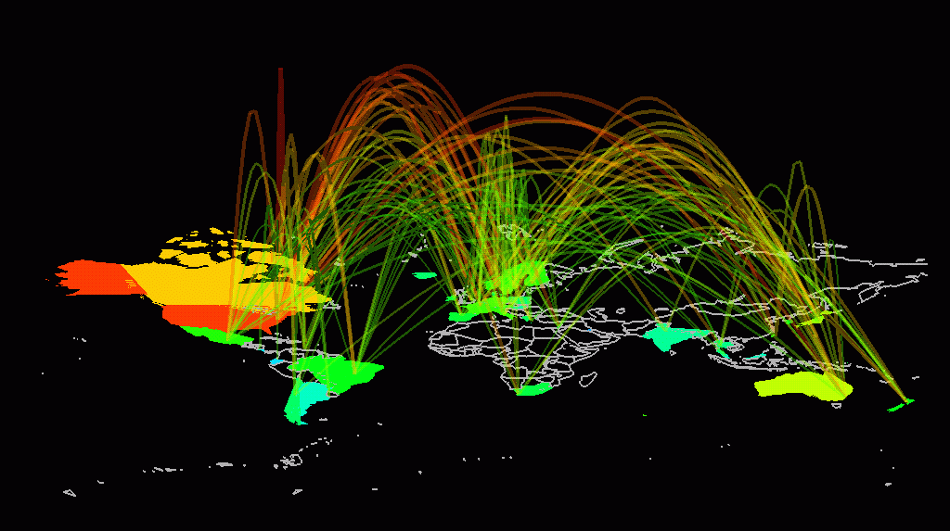
The Atlas of Cyberspace: http://personalpages.manchester.ac.uk/staff/m.dodge/cybergeography/atlas/atlas.html

Slide 16
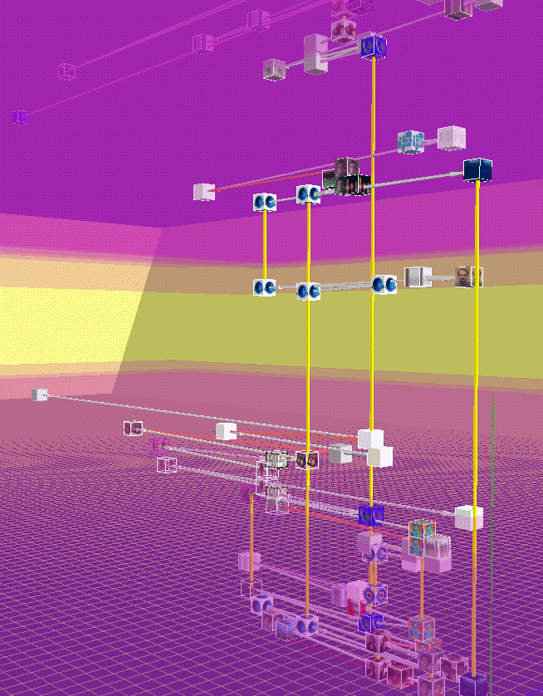
The Atlas of Cyberspace: http://personalpages.manchester.ac.uk/staff/m.dodge/cybergeography/atlas/atlas.html

Slide 17
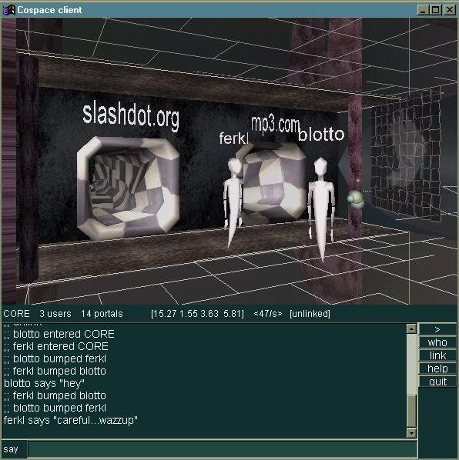
Early 1990s: Cyberspace
The Atlas of Cyberspace: http://personalpages.manchester.ac.uk/staff/m.dodge/cybergeography/atlas/atlas.html
Notes:
Suffice it to say: 15-20 years ago, we talked a lot about ‘cyberspace’ where our avatars could travel through portals to different information spaces

Slide 18
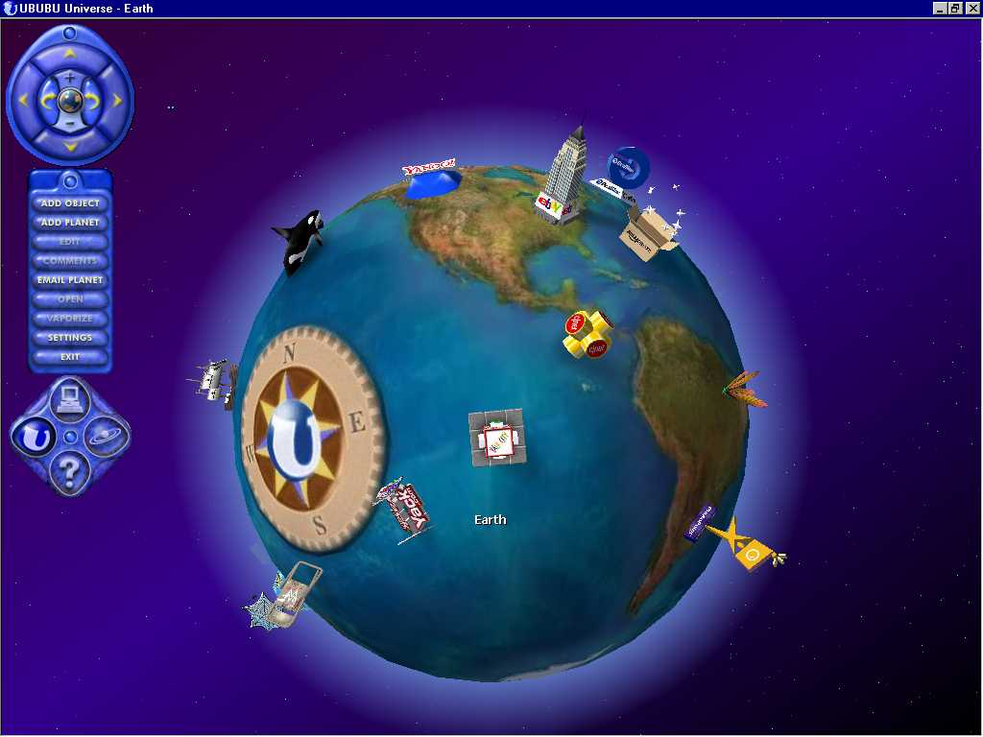
The Atlas of Cyberspace: http://personalpages.manchester.ac.uk/staff/m.dodge/cybergeography/atlas/atlas.html

Slide 19
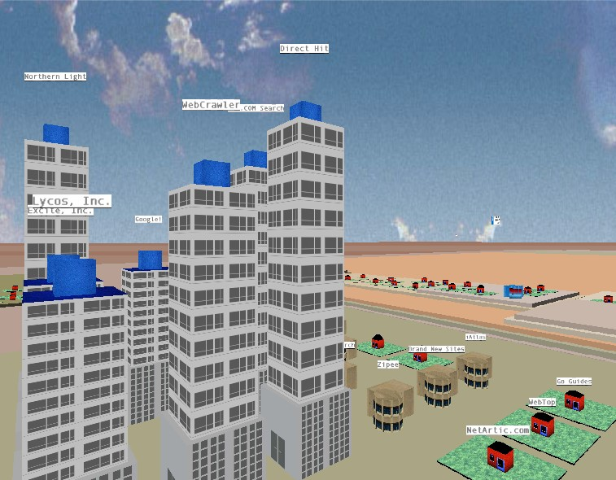
The Atlas of Cyberspace: http://personalpages.manchester.ac.uk/staff/m.dodge/cybergeography/atlas/atlas.html
Notes:
Or live and explore information scapes

Slide 20
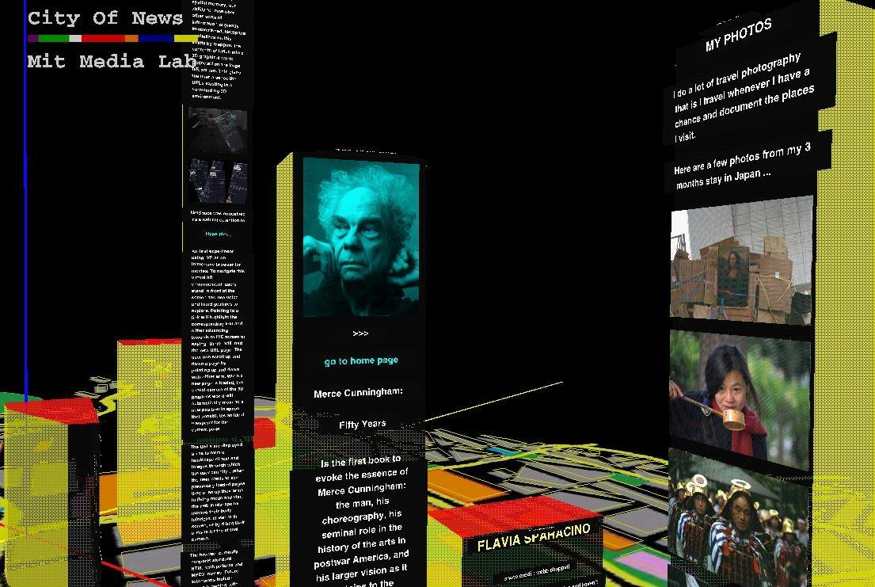
The Atlas of Cyberspace: http://personalpages.manchester.ac.uk/staff/m.dodge/cybergeography/atlas/atlas.html
Notes:
Here’s a depiction of a person’s computer, where the shape and architecture of this space is as important as the actual content.

Slide 21
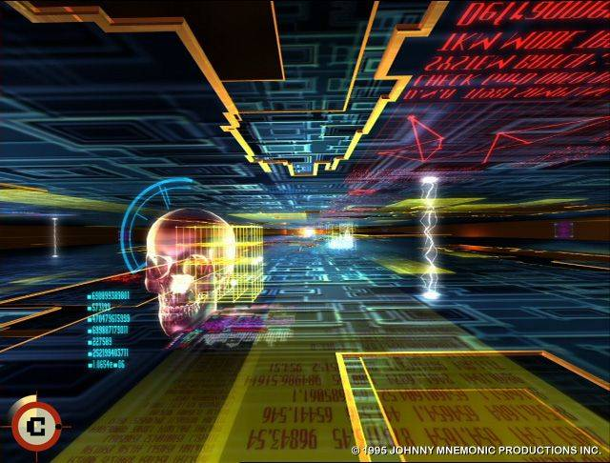
Image from Johnny Mnemonic, 1995
Notes:
We saw this in film also.

Slide 22
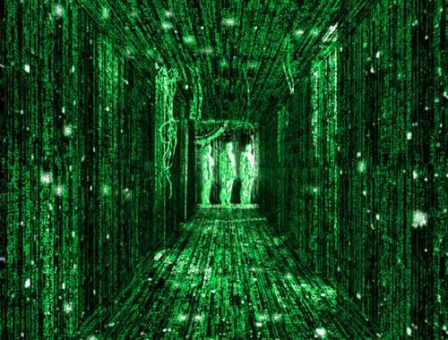
Image from The Matrix
Image from The Matrix
Notes:
And virtual reality.

Slide 23

Notes:
MAKING THE FRAMES OBVIOUS
The early to mid 1990s also marks a time period when postmodern thinking hits the streets in more popular, user friendly form. Films like Pulp Fiction and Natural Born killers, dismantled the barrier between audience and film, self and action of the film. Later, Run Lola Run does another twist on this.

Slide 24


Slide 25


Slide 26
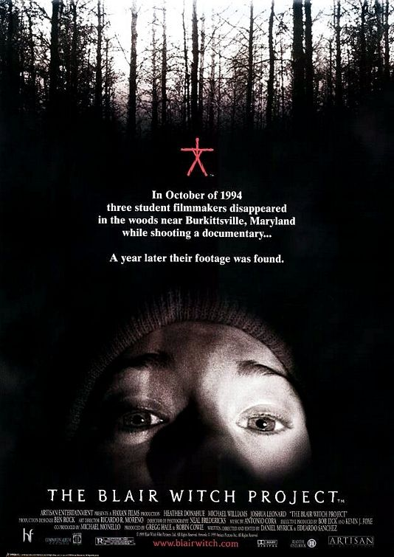

Slide 27
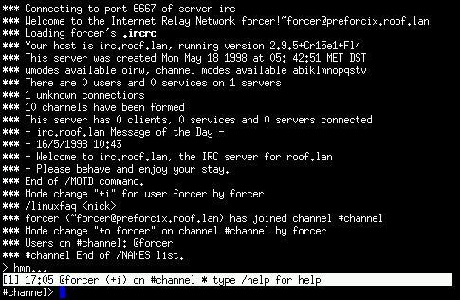
Notes:
And we build online communities with others using ascii text.

Slide 28
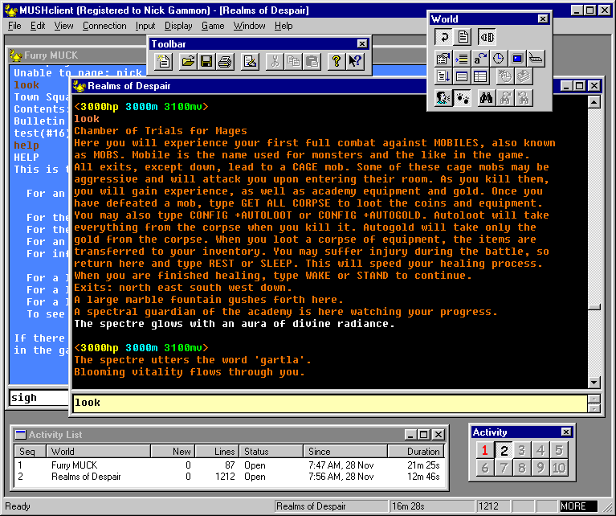
Notes:
If you were lucky, your software had more colors. But the mode of “being with other” in this timeframe is ascii text, primarily.
In certain fields of qualitative inquiry, there’s an impulse to reconsider what counts as research, to embrace autoethnographic or decentered ways of knowing (following the path of Geertz, then Clifford and Marcus and situated feminists like Sandra Harding and Donna Haraway). This is most extremely expressed by interpretive sociology in the U.S., where we see a lot of experimentation with methods of analysis and representation in different genres of writing.
Salient Characteristics of the 1990s
disembodiment
text as being
geographic displacement/dispersion
meant challenges for ethnographic research:
interviewing both online or offline?
authenticity? in the body or in the content of the text?
where is real experience? online or offline or a mix of both?
participation as active building of field boundaries
storing and managing huge amounts of field data
ethical practice of protecting privacy and getting informed consent

Slide 29
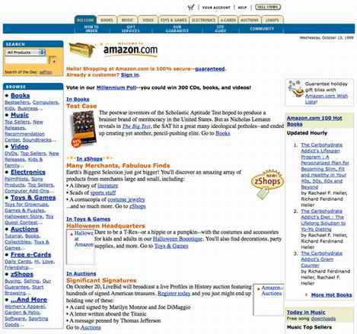
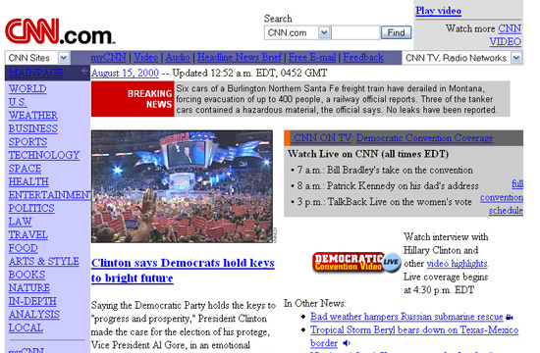
Mid-1990s: “World Wide Web”
Notes:
Then, in the mid 1990s, the focus of research turned to the WWW as a visually dominated space for commerce and personal production of personal pages.

Slide 30
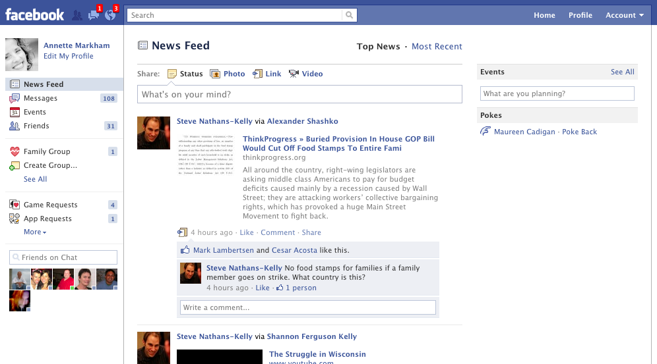
Early 2000s: Web 2.0
Notes:
Concurrently, we see a rise in studying networks, or larger pictures of society, based on the more robust web and the growing social use of the web as a networking tool.
Now, our parameters for what is appropriate for an interface have changed somewhat. If we’re not in a gaming environment or ‘alternative’ space, this is the classic look of the stage upon which we now play.

Slide 31
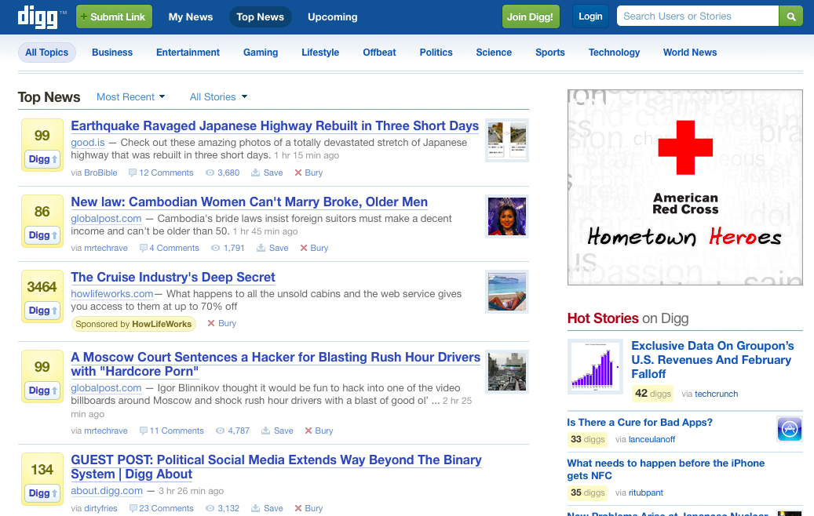
Notes:
The ubiquitous plain interface took hold and firmly influences web design now.

Slide 32
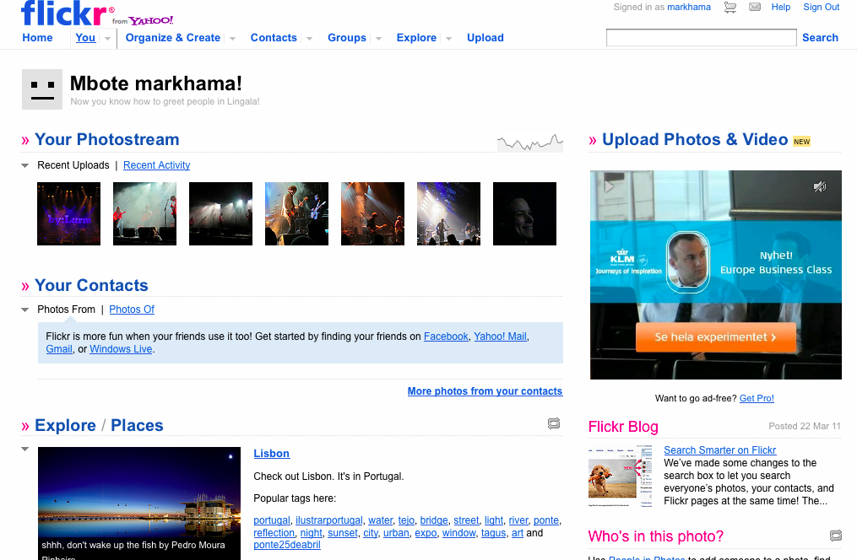
Notes:
Almost every site for social media has the vanilla interface

Slide 33
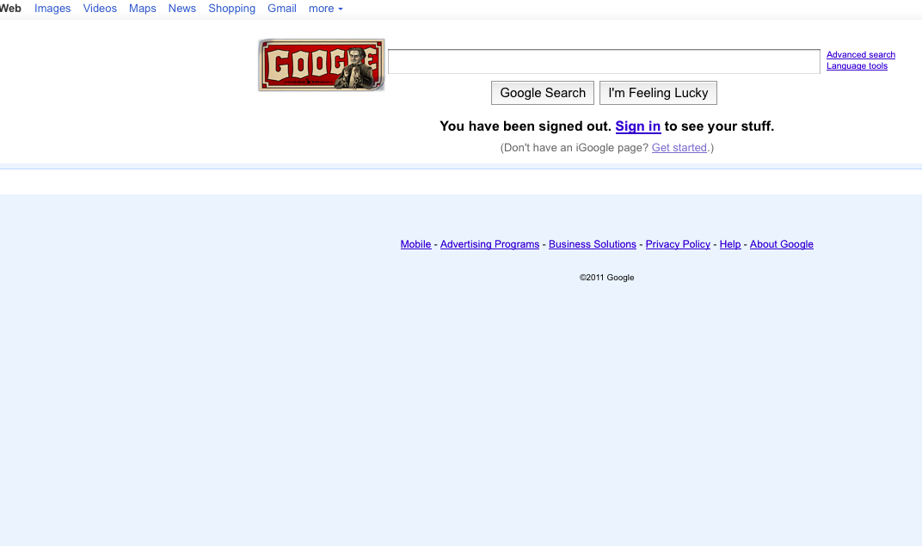
Notes:
Which is expressed most elegantly in the role model: Google.

Slide 34
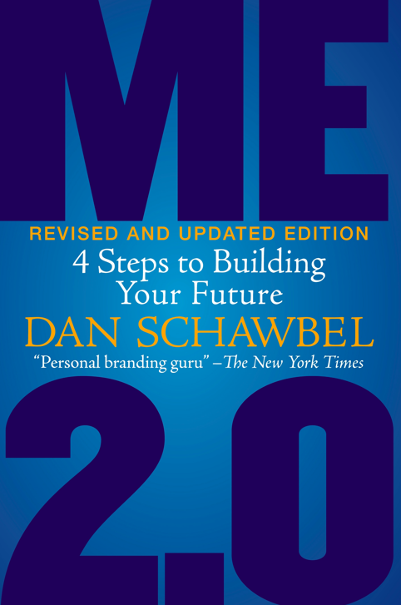
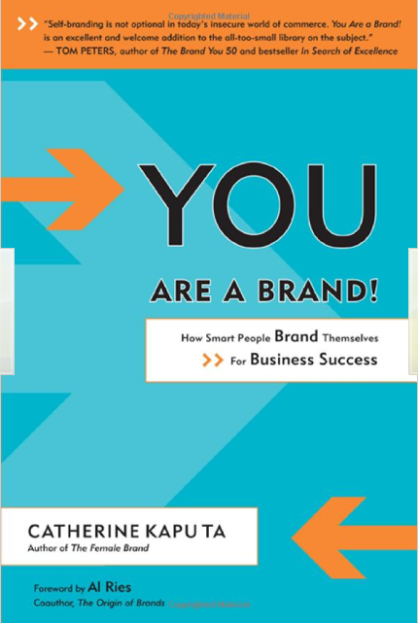
Notes:
in these interfaces, we’re encouraged to be ourselves, or “the good parts” anyway, because we (our authentic self) is a commodity in this information age.

Slide 35

2012: Networked Life
Notes:
Seamless. There’s a device present, but it and your life are inextricable and interwoven.

Slide 36
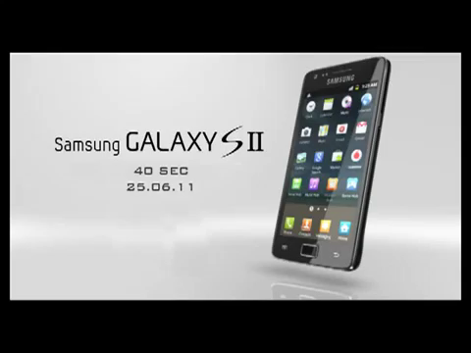
2012: Networked Life
Notes:
Now, it’s about us. It’s just life. there’s still a device, but the computer has disappeared and the frame of experience is different. Everyone and everything is informational, digitized.
to a networked culture... ubiquitous internet.

Slide 37
2012
“Who should I accept as a friend? Everyone I know or just people I like?” (U.S. teen talking about Facebook)
“What role does social media play in protest movements?”
Should I be angry or try to sue people for spreading my photography all over the internet or just be glad I was noticed? (Noam Galai)
“How can musicians engage their fans through social media?” (Nancy Baym)
Notes:
It’s no wonder the questions have shifted. Instead of radicalizing the cultural parameters, we’ve (or they’ve) erased the obviousness, created interfaces that are transparent.
whereas we used to see the frames out there in front of us, we now have stepped into the frames.
IMPORTANT: I don’t mean to imply these plain interfaces are the only way we experience media and internet. There’s a huge range of experience possible in vivid color and movement and detail.
My point is that we’ve experienced a serious frame shift in the life of internet to date. Early internet research practice was built in the days when we called it Cyberspace. and this, along with some other things, cannot help but influence the way we conceptualize research contexts, and therefore research methods. CLICK! (explain on next page)

Slide 38
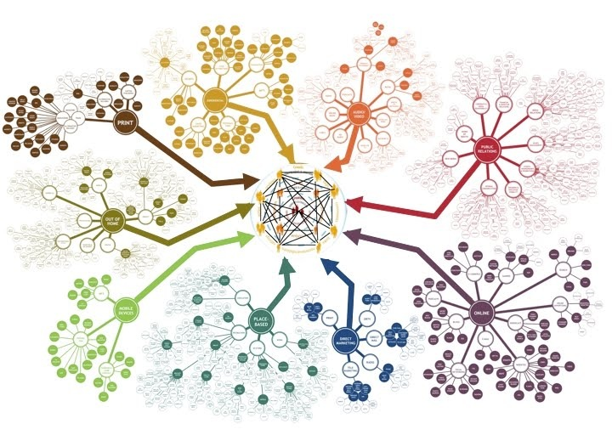
Where to begin?
Where to go?
Where to end up?
Notes:
Research contexts look more like this
It’s difficult to know where to begin, much less where to go. And where you’ll end up? That’s perhaps the most important question, because it marks a shift from thinking about the project as something stable to thinking about it as an argument you make.
This is made more difficult by the fact that CLICK

Slide 39
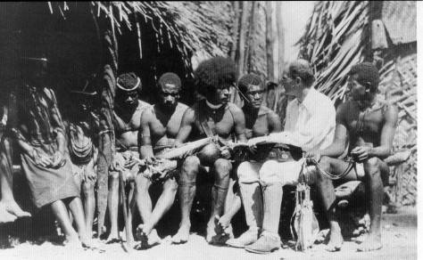
Notes:
our models for researchwere designed for contexts like this. This picture illustrates the idea (or ideal) of the classic ethnographer in the simply bounded (homogeneous, local) field. This is Malinowski in the midst of fieldwork. (of course, this is an exaggeration, but it illustrates the juxtaposition, or disjuncture of traditional concepts and contemporary culture)

Slide 40
Typical Method Texts
Research Question
Collect Data
Sort and Code
Analyze and Interpret
Write up Findings
Notes:
this remains the main training model for qualitative inquiry. A linear, straightforward process. It might be complicated by feedback loops that iteratively inform the project, but this doesn’t impact much the myths about the linear qualities of inquiry.

Slide 41
Critical
Junctures
?
?
?
Notes:
For me, reimagining inquiry or breaking loose of the limitations structured into traditional models starts by going back to the basic question. What is the process of research?
One way to answer the question is to say, research is a series of choices. Methods are choices made at critical junctures.
So critical junctures are those moments when we make decisions that lead us down one path and notably, NOT others.
Every time we make a choice, we erase other possibilities. Rather than ignoring or diminishing this fact, embracing it can help free the researcher from the false constraints associated with believing that the process is clean or neat, or that the outcome will be a complete vision or explanation of the whole thing. Inquiry has never been about that.

Slide 42
Critical Junctures
Constructing the question
Defining field boundaries
Accessing participants
Collecting information
Filtering and organizing information
Analyzing data into general themes
Interpreting general themes
Representing self and other in writing
Framing knowledge for audiences
Notes:
Each of these junctures involves active behaviors on the part of the researcher.
Each of these utilizes a unique method or tool, whether or not this methodology is articulated or deliberate.
Example:
Where to cut off participant list
Which search engines to sample
Which language to speak
Whether to restrict interaction to online or take offline to f2f
What time of day to seek interviews
What time zone to use
Some = questions of logistics, some decisions made by convenience. All of these with ethical implications.
ALL OF THESE DECISIONS ARE ETHICS DECISIONS. WITH CONSEQUENCES:
Consequences for the human subject, sure. That’s what we are taught to focus on because of the daunting presence of ethics review committees. But there are so many more consequences when we look more deeply at our methods as choices.
Of course, this list is partial. To identify all of the junctures one faces in the course of a project would take forever.

Slide 43
Framing Knowledge for the audience
Generating Questions
Representing self and other in report
Determining field boundaries
Decision Points
Critical Junctures
Identifying objects of analysis
Interpreting findings
.
Analyzing ‘texts’
Accessing Participants
Discarding information
Collecting Information
Sorting into general themes
Sorting and filtering ‘data’
Notes:
When you think about all the practical as well as methodological choices you make, it gets a bit dizzying. This is just another graphic of the previous side, showing it in a less linear order.

Slide 44
Remix
Method
Interrogate
Play
Borrow
Move
Generate
Notes:
Here’s my idea about method, through the lens of remix. A remix method approach is a way of focusing on the process of sensemaking.
Underlying this model =
the fact that research is always question driven, not method driven
The idea that building scientific knowledge is only one but not the only goal of research.
That research should be messy, jumbled, non linear, and hopefully, play as well as work.
that our individual products, and the entire academic enterprise, is a process of contributing pieces of an ongoing conversation; that understanding takes place over time and in a collaborative, creative way. Which moves us away from finding “the answer” and more toward ‘making good arguments”
how to do it well?
reflexivity
interpretive authority
But seriously, what does it involve?
Borrowing. Taking the ‘best of’ from a range of approaches.
Generating
Moving
Playing (practicing, testing, rehearsing)
Interrogating
But seriously, what does it involve?
Borrow from anything. Any way of knowing. Any epistemological framework. Any philosophy. Any art
Generate lots of data
Play with multiple methods, testing and practicing
Move. As in shift your perspective, change the questions, follow the data, move in and out of the flow of information
Interrogate the self, the project, the purpose. All the time. That’s where ethics comes from.

Slide 45
Purpose of
Research
Description
Understanding
Explanation
Prediction
Control
Critique
Knowledge Accumulation
Political Justice
Therapy
Self-Serving
Other-serving
Notes:
A remix lens should prompt us to consider not just how we’re doing research, but why. When we invoke a term such as ‘play,’ or ‘borrow,’ we’re questioning some of the foundations of traditional social science (whatever that is). In doing so, it’s important to reflect on the function or purpose of research.
This list, for example, shows a range of reasons we might conduct research. If we situate ourselves on this list, and consider methods as an open ended question (starting somewhat tabular rossa, as I mentioned earlier in talking about methods as a series of actions, made on the basis of choices one makes at critical junctures), we can begin to see a broader spectrum for what counts as appropriate inquiry.
But often, we don’t focus on this because it’s assumed, rather than identified and interrogated. Especially in the early stages of one’s career, the focus is on the first six categories. The seventh is assumed to be the goal. If political justice is served, that’s fine, but this, or therapy, is often seen as only a sideline to the primary objective, something that adds value but is generally not thought to be the sole purpose of research. As for the last two, these are not much addressed, but everyone knows these are in play.
It begins to make more of a difference when we see how this list of GOALS or PRODUCTS influences the way we think about research PROCESS.

Slide 46
Note Absence. Silence. Deletions.
Talk formally
Participate,
Observe
Look for traces of presence
Generate
Identify Objects, Technologies
Talk to others,
Talk to yourself
Explore shifts over time
Actions or evidence of actions.
Map the Situation: Structures, Meaning, Norms, Institutions
Notes:
What exactly are we focusing on as ‘data’ which will be used to measure, assess, describe, contain, and further delimit the object of analysis? What perhaps matters as much as the answer to this question is this: What should we be generating in order to make sense of contemporary phenomena?
Generate may be a better term than collect, in that it’s clear that we are not in a simple position of looking at a discrete set of possibilities and then selecting some stuff out of a pile to call data. Rather, as we move and shift with moving and shifting phenomena, “stuff” is generated (or could be) that we then later label ‘data’ suitable for analysis.

Slide 47

Japan Earthquake 2011

Slide 48
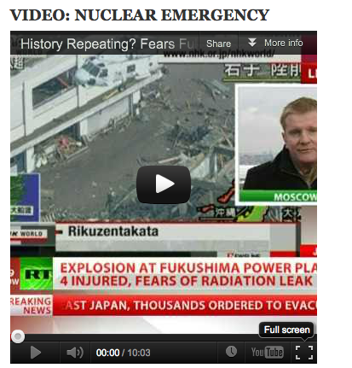
Layers of input (meaning)

Slide 49
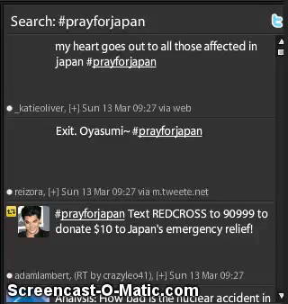

Notes:
Multiple interfaces and collaborative production of information.
Personal and official sources
Interactions with new people all the time.

Slide 50
Dramaturgy
Semiotics
Documentary Filmmaking
Borrow
Collaborative Arts Methods
Symbolic interactionism
Mathamatical Modeling techniques
Social Network Analysis
Studies of Affect
Actor Network Theory
Rhetorical Criticism
Etc., etc.
Notes:
Notice, ETHNOGRAPHY IS NOT HERE. This is because the entire approach is somewhat, if not fully ethnographic, in the richest sense.

Slide 51
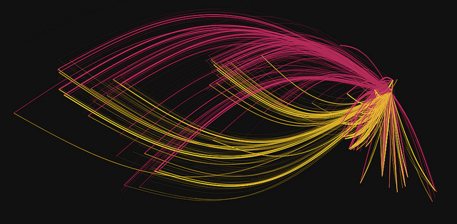
http://blog.twitter.com/2011/06/global-pulse.html

Slide 52
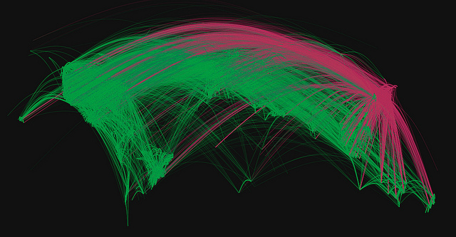
http://www.flickr.com/photos/twitteroffice/5884626815/in/photostream/

Slide 53
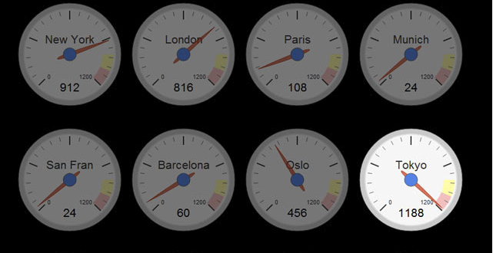

Slide 54
Follow the Thing
Follow the
Opposites
Follow the People
Generate
Follow the silence
Interrogate
Move
Follow the Plot, Story, or Allegory
Follow the movement
Follow the metaphor
Follow the intersections
Follow the …etc., etc.
Notes:
Move is a way of thinking about loosening up, motion, jarring, shifting perspective, etc.
Also moving where the wind blows you …or where the data takes you.
….or moving through the first “question door” into the others, changing questions…

Slide 55
From Materiality
to Memes
Geography, history
Norms, Practices
Twitter
Agronomy in Island States
SMS
EVENT
News Wire Services (AP, Reuters)
Revisit nuclear safety
GM layoffs in U.S.
Facebook updates
Additive quality of tragedies in the news
Vimeo, Youtube
E-Invite to prayer circle
American connection to Japan through Anime
Notes:
A way to think about movement is to consider how an event or situation plays out via social media. Although it begins with materiality, it swiftly shifts to cultural units of information more identifable as memes.
These are some impressions I have of japan within a couple of weeks of the event.
we’re learning a lot about japan.
it’s geography, it as an island state (large, powerful), old culture, closed for so long,
we see it in photo, before and after (pictures overlaid)
the iconic images of japan in anime, science fiction, technology, world war II,
mixing with the shifting physical images of catastrophe that is not across the country but all encompassing. flayed open.
everyone has something to say, everyone praying,
the last time it was that open was hiroshima, and in a completely different, one way, broadcast media
private closed society, on display for the world
everyone has a view, an opinion
how we transmit info and the national way it’s distributed or framed, per country
personal stories and personal networks of information transmission (phone, blog, twitter, fb)
so many different levels, but channeled depending on what your ‘go to’ access is for information.
Yet even within (as well as across) it’s layered. and each layer has such complexity.
http://www.youtube.com/watch?v=ROaIknIk9LA
history of nuclear accidents and how you deal with emergencies from the 1950s, being invoked by people watching the news
living on islands, the discussion of water, flooding, agronomy, water and radiation, milk and radiation.
impact on the auto industry. GM announced closing a plant because they can’t get parts from japan. the ‘fallout’ in very specific industries around the world, in technology parts.
anime and the relationship of particular people
this is not even talking about the impact on people there, people directly related to the event
and so one’s information flow certainly impacts how we frame and experience not only the catastrophe there but social and political life in one’s own country.
negative response about the speed (lack of) of the company that runs the nuclear plant.
man on the street interviews
video clips from tsunami
everything is different in an island state.
These impressions help me identify how rapidly or radically ideas can shift among or across cultural groupings, in very short periods of time. It’s about shifting opinion, in some ways, and this occurs all the time. But it’s also about how the ‘object’ of analysis is constantly moving, particularly if linked to social media forms of interaction. Focusing on it helps me problematize the obdurate qualities of those things we call the objects of our analysis.

Slide 56
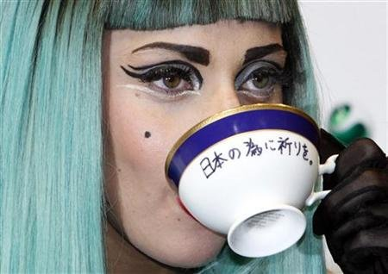
Notes:
Lady Gaga at a press conference where she’s talking about and supporting efforts to help with the Japanese earthquake. Drinking tea from a cup that says “pray for japan”

Slide 57


Slide 58
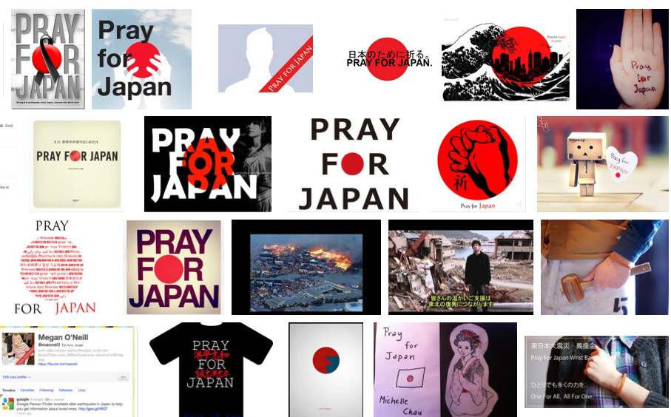

Slide 59
Social Network Analysis
Deconstruction
Metaphor Analysis
Generate
Play
Conversation
Analysis
Narrative Analysis
Argument Analysis
Etc., etc.
Notes:
Play is not about creating a final product. It’s about practice and experimentation. Notably, this may not be stuff that ends up in a form for an audience, like a performance at a jazz club. It may be just practicing one’s scales at home.

Slide 60
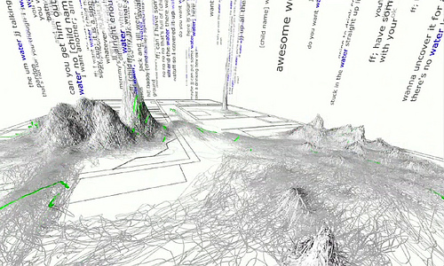
Notes:
Playing with one’s data in different ways so different cognitive centers are activated.
This data is a screencapture from a TED talk by Deb Roy, who recorded all audio/video in his household after his son was born. This is data, over time, showing the acquisition of the word “water.” The peaks, trails and so forth illustrate where in the house the word water is spoken, and where people are moving as they use the word (roughly. See the TED talk for better detail about this point). The peak in the center of the screen is the kitchen sink.

Slide 61
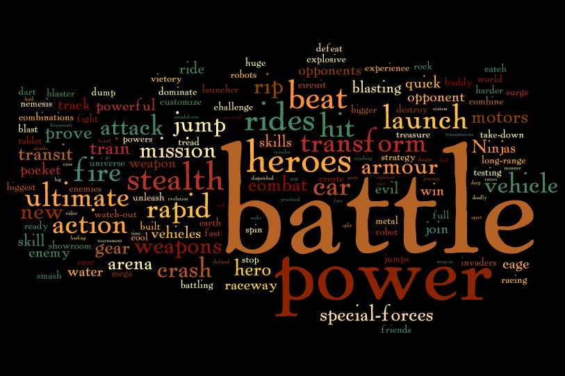
Notes:
Boy’s toy advertisments: Wordle

Slide 62
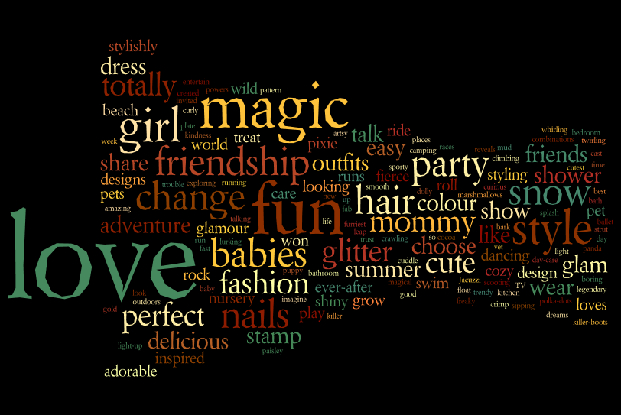
Notes:
Girl’s toys advertisments: Wordle

Slide 63
Where am I? What is my standpoint?
What am I choosing as the point of analysis?
Generate
Interrogate
When am I doing research?
What am I leaving out? Why?
Interrogate
(perspective)
Who are the relevant actors/participants, beyond the obvious?
How am I cutting into the topic?
Notes:
Interrogation is a reflexive self questioning. A way of assessing one’s own actions, all the time, iteratively constantly (think of how a musician hears his or her own performances, or athletes scrutinize their own game play)
This slide illustrates some questions that might get asked from the inside out. From the RESEARCHER’S perspective.
You can’t ask what is the object without asking these other questions, which really help you realize, reflexively, what you’re up to.

Slide 64
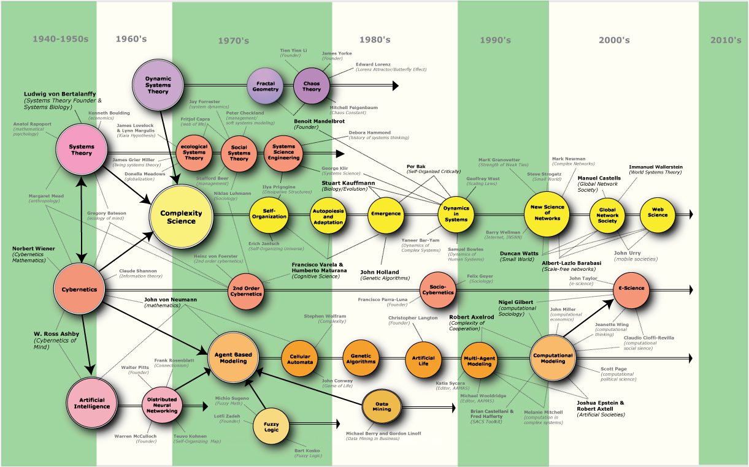
Notes:
Situate your frameworks

Slide 65
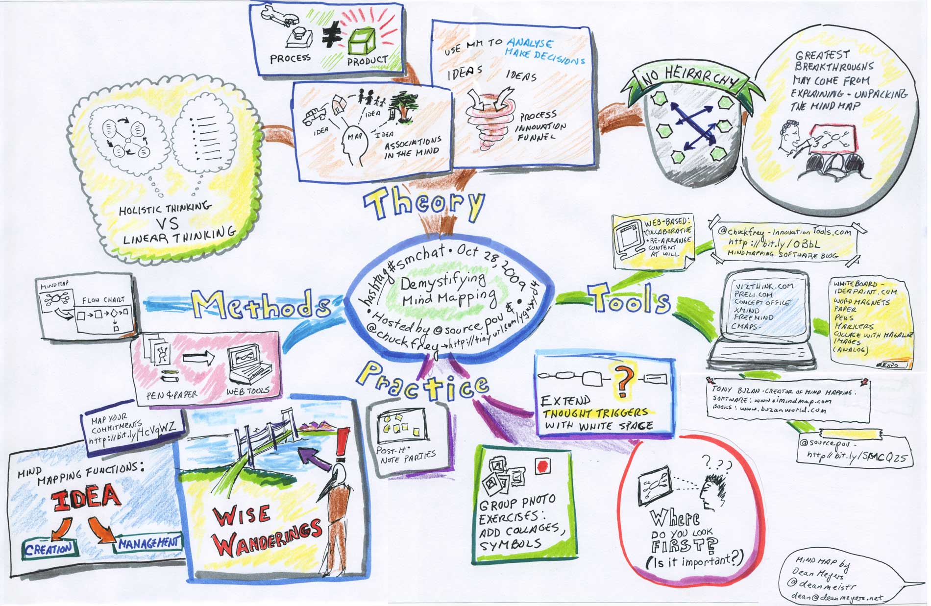
Notes:
Situate your ideas (draw more!)

Slide 66
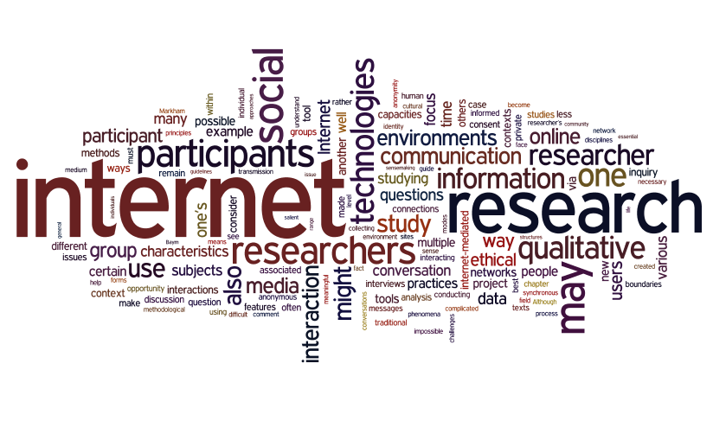
Notes:
Defamiliarize your work: Here’s a paper I wrote on ethics, and funny. I don’t see that word anywhere.
There are varying degrees of relevance to this sort of visualizing. In some work, it might not be that important. In other contexts, it could be quite relevant, as we saw in the boy’s and girl’s toy advertisments.

Slide 67
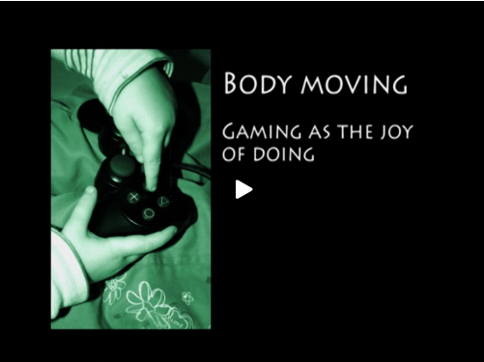
http://www.audiovisualthinking.org/videos/bodies_movin/
Notes:
This is a great example of a researcher whose contributions are based on the fact that she was able, albeit reluctantly, to move. She followed where the camera fell, when it accidentally shifted from her brother’s game screen to his hands on the keyboard.
It’s also an example of play, borrow, and interrogating one’s own perspective. Which helps us see that all the processes involved in inquiry are interlinked, potentially simultaneous, and inter-informative. http://www.audiovisualthinking.org/videos/bodies_movin/

Slide 68
What is my point of entry? When and how was it first encountered?
Lived experience of the thing, moment
Generate
How might it look/appear otherwise?
Interrogate
When and where is it situated, politically? personally?
Interrogate
(object)
How might it either/both resonate or conflict with “other”
What surrounds it, physically?
Why this and not something else?
Notes:
Likewise, one can apply some reflexive interrogation to object with fruitful results

Slide 69
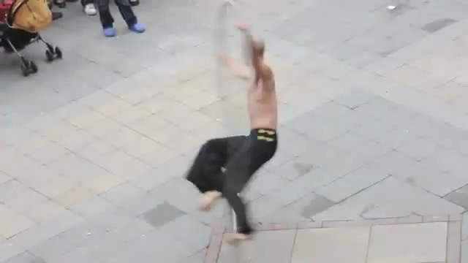
Notes:
Seen alone, this video is certainly interesting

Slide 70
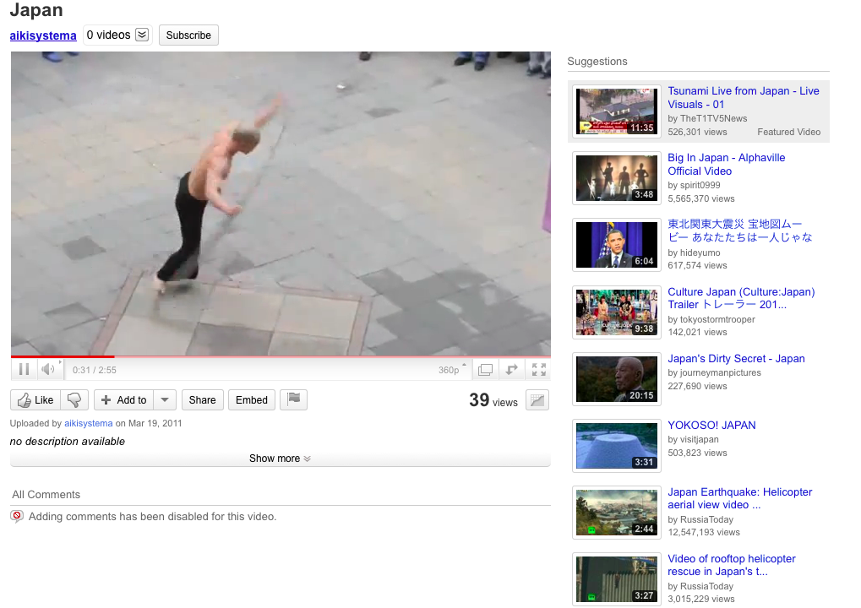
Notes:
But it swiftly becomes more layered when we see what surrounds it physically.
Then, if we add more context, to say that it was posted on facebook by a 13 year old boy and forwarded to me by his mother, then we see how it lives in more context.
Then, it gets even more complex when we realize (if we realize) that the language being spoken is Mandarin, which means the label “Japan” is wrong.

Slide 71
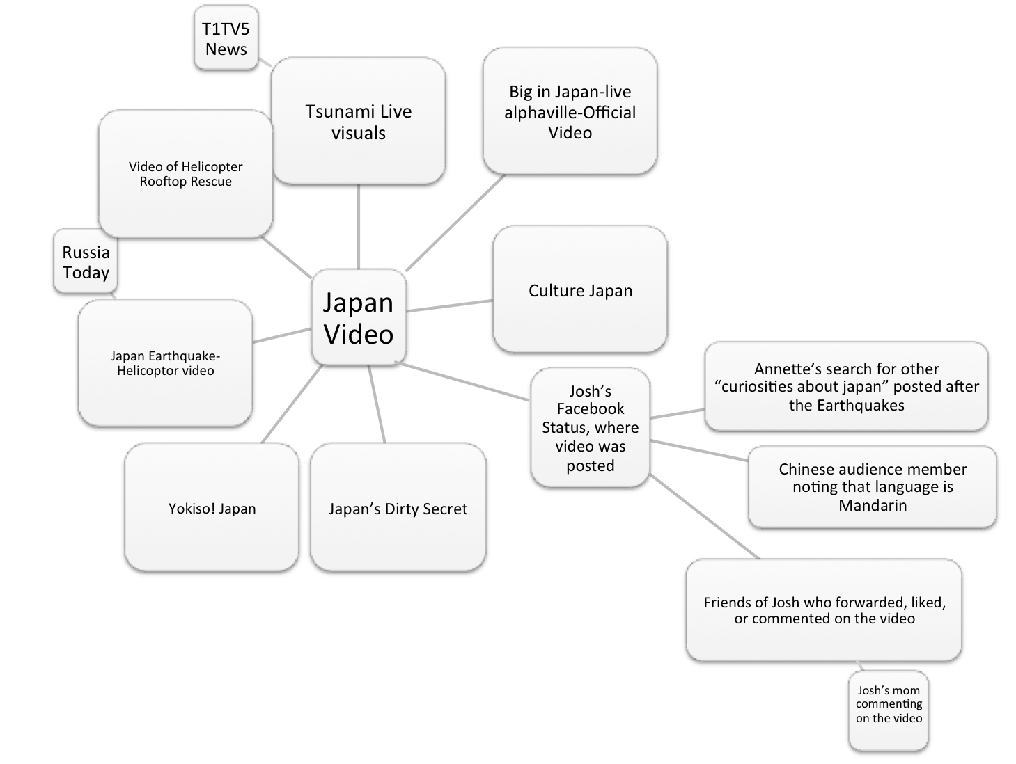

Slide 72
Remix
Method
Interrogate
Disciplinary Integrity
Contextual Integrity
Creative Integrity
Disciplinary Integrity:
Play
Borrow
Generate
Move
Notes:
Shifting to talk about credibility and rigor, two important criteria for quality in the social sciences. Must shift away from frameworks such as “validity” and “replicability,” of course, which have been problematized for several decades. But to figure out how to make this approach/orientation more acceptable as a viable method, certain criteria must be applied.
Good quality research always adheres to certain criteria. It’s often a matter of identifying the standards that were applied, the systematic processes that were used, and so forth.
Here are three interwoven ideas about integrity: Creative integrity, contextual integrity, and disciplinary integrity. I give this last one a nod only because it’s already present, most likely. Otherwise, I would frame it differently, since the goal is not to adhere to one’s discipline in the rigid sense, but to give integrity to the roots and foundations of one’s discipline, which, prior to codification and institutionalization, probably had more flexible characteristics. Also, certain areas of inquiry are not as disciplined as others, so there’s already strong currents of interdisciplinary, flexible approaches in play.

Slide 73
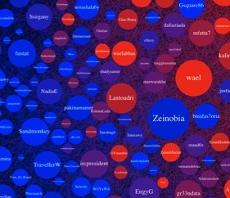
Disciplinary Integrity
Research Question
Collect Data
Sort and Code
Analyze and Interpret
Write up Findings

Slide 74

Contextual
Integrity
Reflexivity
Transparency
Interpretive Authority
Notes:
Reflexivity:
Transparency:
one way to demonstrate the rigor of the analysis is to build transparency into the account, which may include the following:
Identify and describe the steps of sensemaking from raw experience to final argument.
Describing the development of relevant questions, walking readers through decision-making processes, and including samples of analytical reasoning helps to demonstrate interpretive competence. It also walks the audience through one’s logic, rather than assuming the reader would follow that same path of reasoning.
Show, rather than tell. Whenever possible, provide rich descriptions and samples of dialogue and interactions. Because these may include composite accounts,
Make the researcher’s role visible in the field and the analytical process of transforming social experience into an audience-specific audience. This alleviates the pressure to provide an omnipotent report of the whole and clarifies the notion that the research findings are a product of one’s participation and choices; a selection from a range of possible options in writing culture.
Defend the researcher’s authority by offering examples of how data is transformed without loss of fidelity. Creating strong connections between discursive practices and findings is not automatic, but designed through careful and reflexive analytical procedures. Demonstrating these with specific examples is like showing the steps in math homework. It helps the audience accept that your rendering is viable.
Interpretive Authority:

Slide 75

Creative
Integrity
Generate
Play
Borrow
Move
Interrogate

Slide 76

Layered Accounts
Notes:
The goal, perhaps, is to create layered accounts. This image of GIS is one way to think about it, but in many ways is also limiting because it presumes that if we collapsed all these layers, we would have a complete knowledge set about the situation or landscape.
A better way to think about these layers is as an artist or architect or designer would, as iterative renderings of the situation. Each is a work in progress. All are possibilities. Each iteration builds on the others, informs the others, and influences the overall perspective one ends up with at the end. The idea of iterative renderings resonates closely with remix because it also implies an unending process. Clearly, Picasso could have kept going, after his 50 or something renderings of Ma
Layer the researcher’s voice in a different way

Slide 77








Layered Accounts
Notes:
An interesting way to think about these layers is as an artist or architect or designer would, as iterative renderings of the situation. Each is a work in progress. All are possibilities. Each iteration builds on the others, informs the others, and influences the overall perspective one ends up with at the end. The idea of iterative renderings resonates closely with remix because it also implies an unending process. Clearly, Picasso could have kept going, after his 50 or something renderings of this same little girl in the painting. (source?!)

Slide 78

Layered Accounts
Notes:
Another angle to consider is the way layering can illustrate juxtaposition, disjuncture, discontinuity. So rather than trying to resolve complexity in the research project, a layered account can illustrate very clearly the irresolvable complexity of the phenomenon. So instead of ending up with a tidy, neat, summative description of the phenomenon, one ends up with something else. Perhaps less satisfying if one is looking for comprehension of the situation, or an easy answer.

Slide 79


Resonance, not
Replication
Notes:
Yet another way to consider the idea of remix is through the idea of method acting. Here, these two actors are extremely good at providing resonance. We end up with a powerful rendering of Johnny Cash and Edith Piaf. But we’re not seeing these people through a clear looking glass. This stance of resonance is useful for embracing the reseacher’s role of providing an impression of the situation, produced through many internal and external, known and unknown filters.
We long ago rejected the correspondence theory of truth, but in some ways, our textbook discussions of methods still promote the idea that we researchers can somehow be invisible portals, clear conduits that simply facilitate the flow of raw data from the phenomenon through the methodological filter, to the findings.

